Slide 1



2021
State of Computer Science Education
Accelerating Action
Through Advocacy

Slide 2










Thank you for your support of computer science education

Slide 3
The Fifth Annual Report
This report includes:
A summary of national momentum and trends
A description of nine state policies prioritizing computer science education
Data on computer science access and participation (the K–12 CS Access Report)
State summaries

Slide 4
New This Year
Participation data in foundational computer science courses, by demographic
Preliminary K–8 access and participation data
Online interactive data visualization

Slide 5
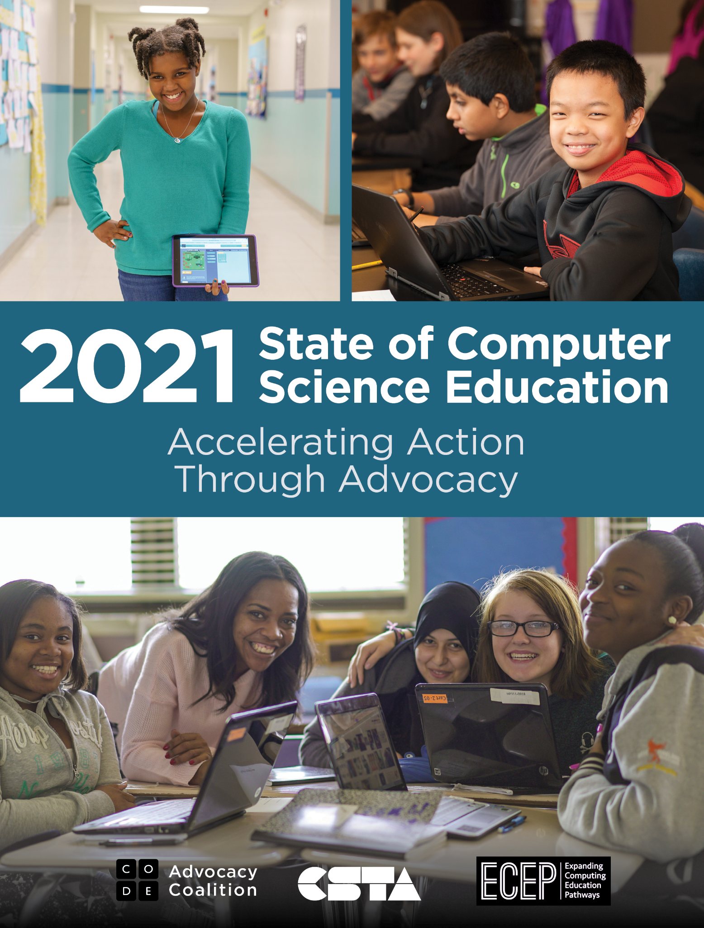
November 3, 2021
Embargo Lifts
Blog Post
CSEdCon Keynote

Slide 6
Key Takeaways

Slide 7
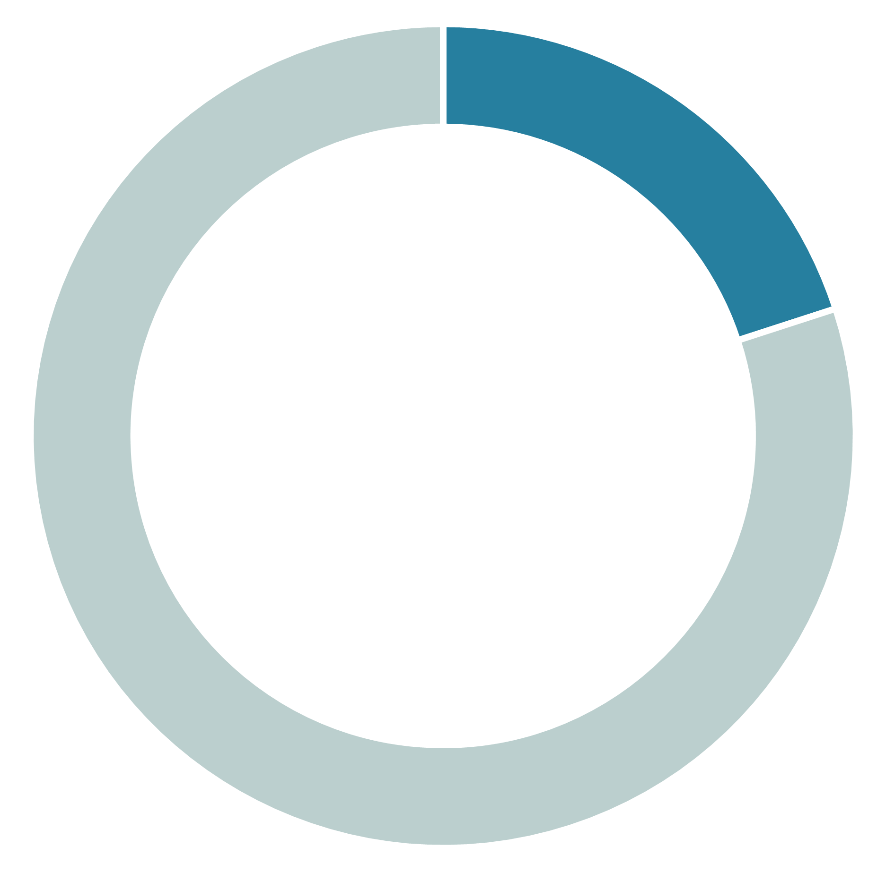
Foundational computer science is offered in 20% of the 174 high schools located on Native American reservations
20%
of high schools located on reservations offer computer science

Slide 8
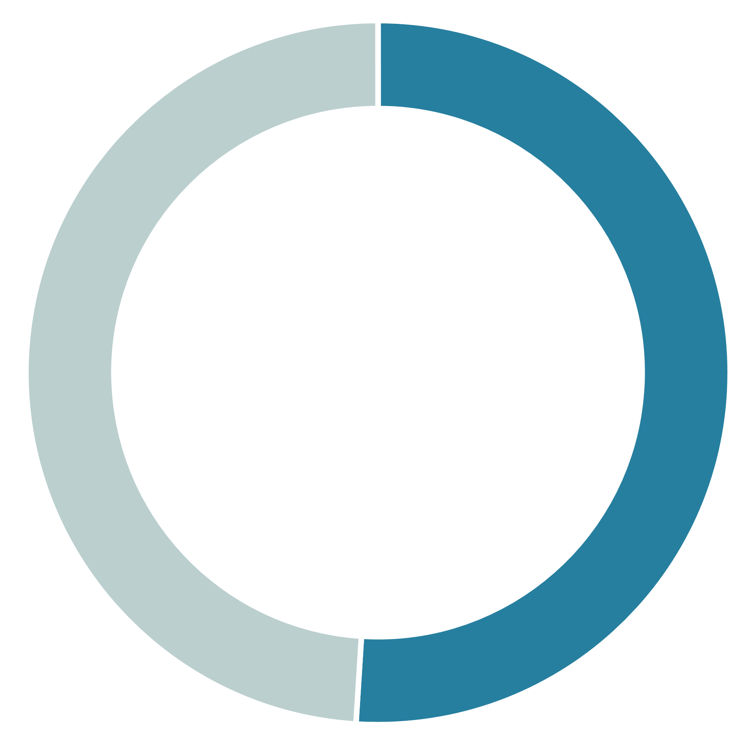
Only half of all high schools offer computer science
Only
51%
of high schools offer computer science

Slide 9
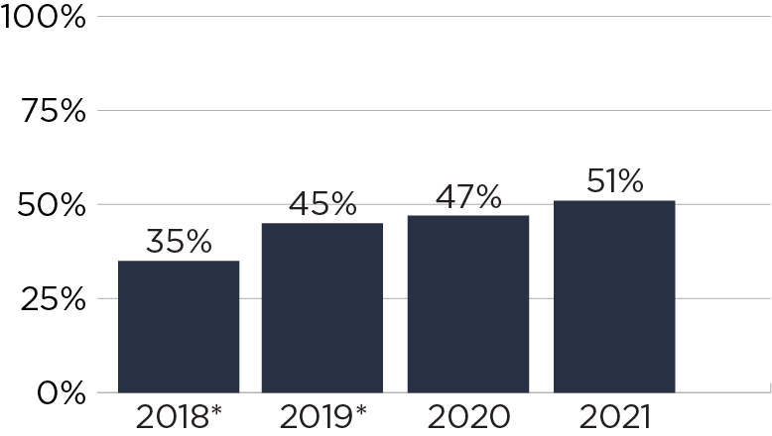
Percent of High Schools
Offering CS Over Time
*2018: based on 24 states, 2019: based on 39 states

Slide 10
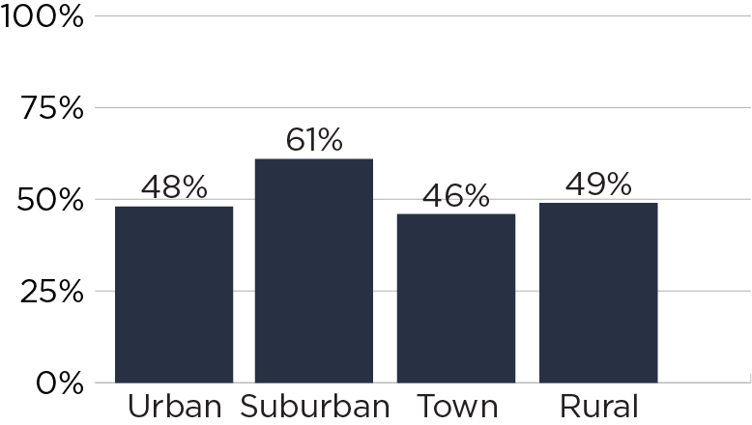
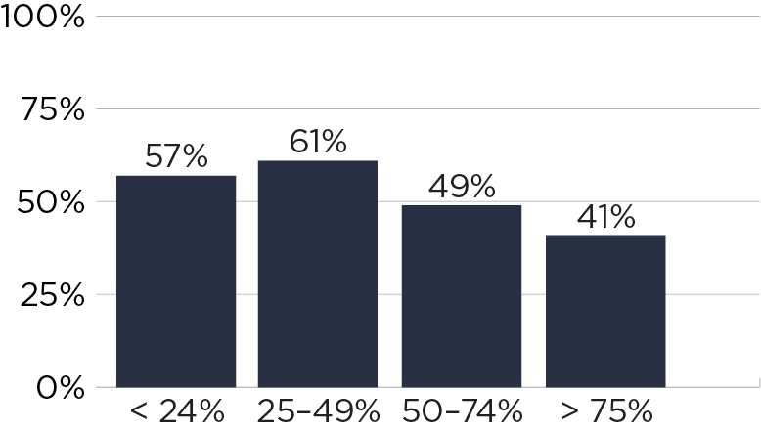
Disparities in Access
Geography
Percentage of FRL in the School

Slide 11
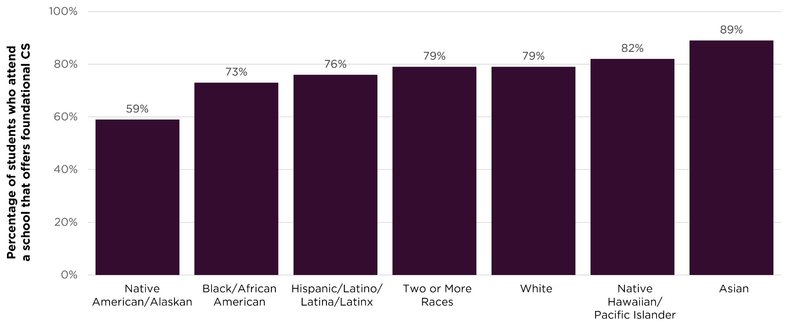
Disparities in Access

Slide 12
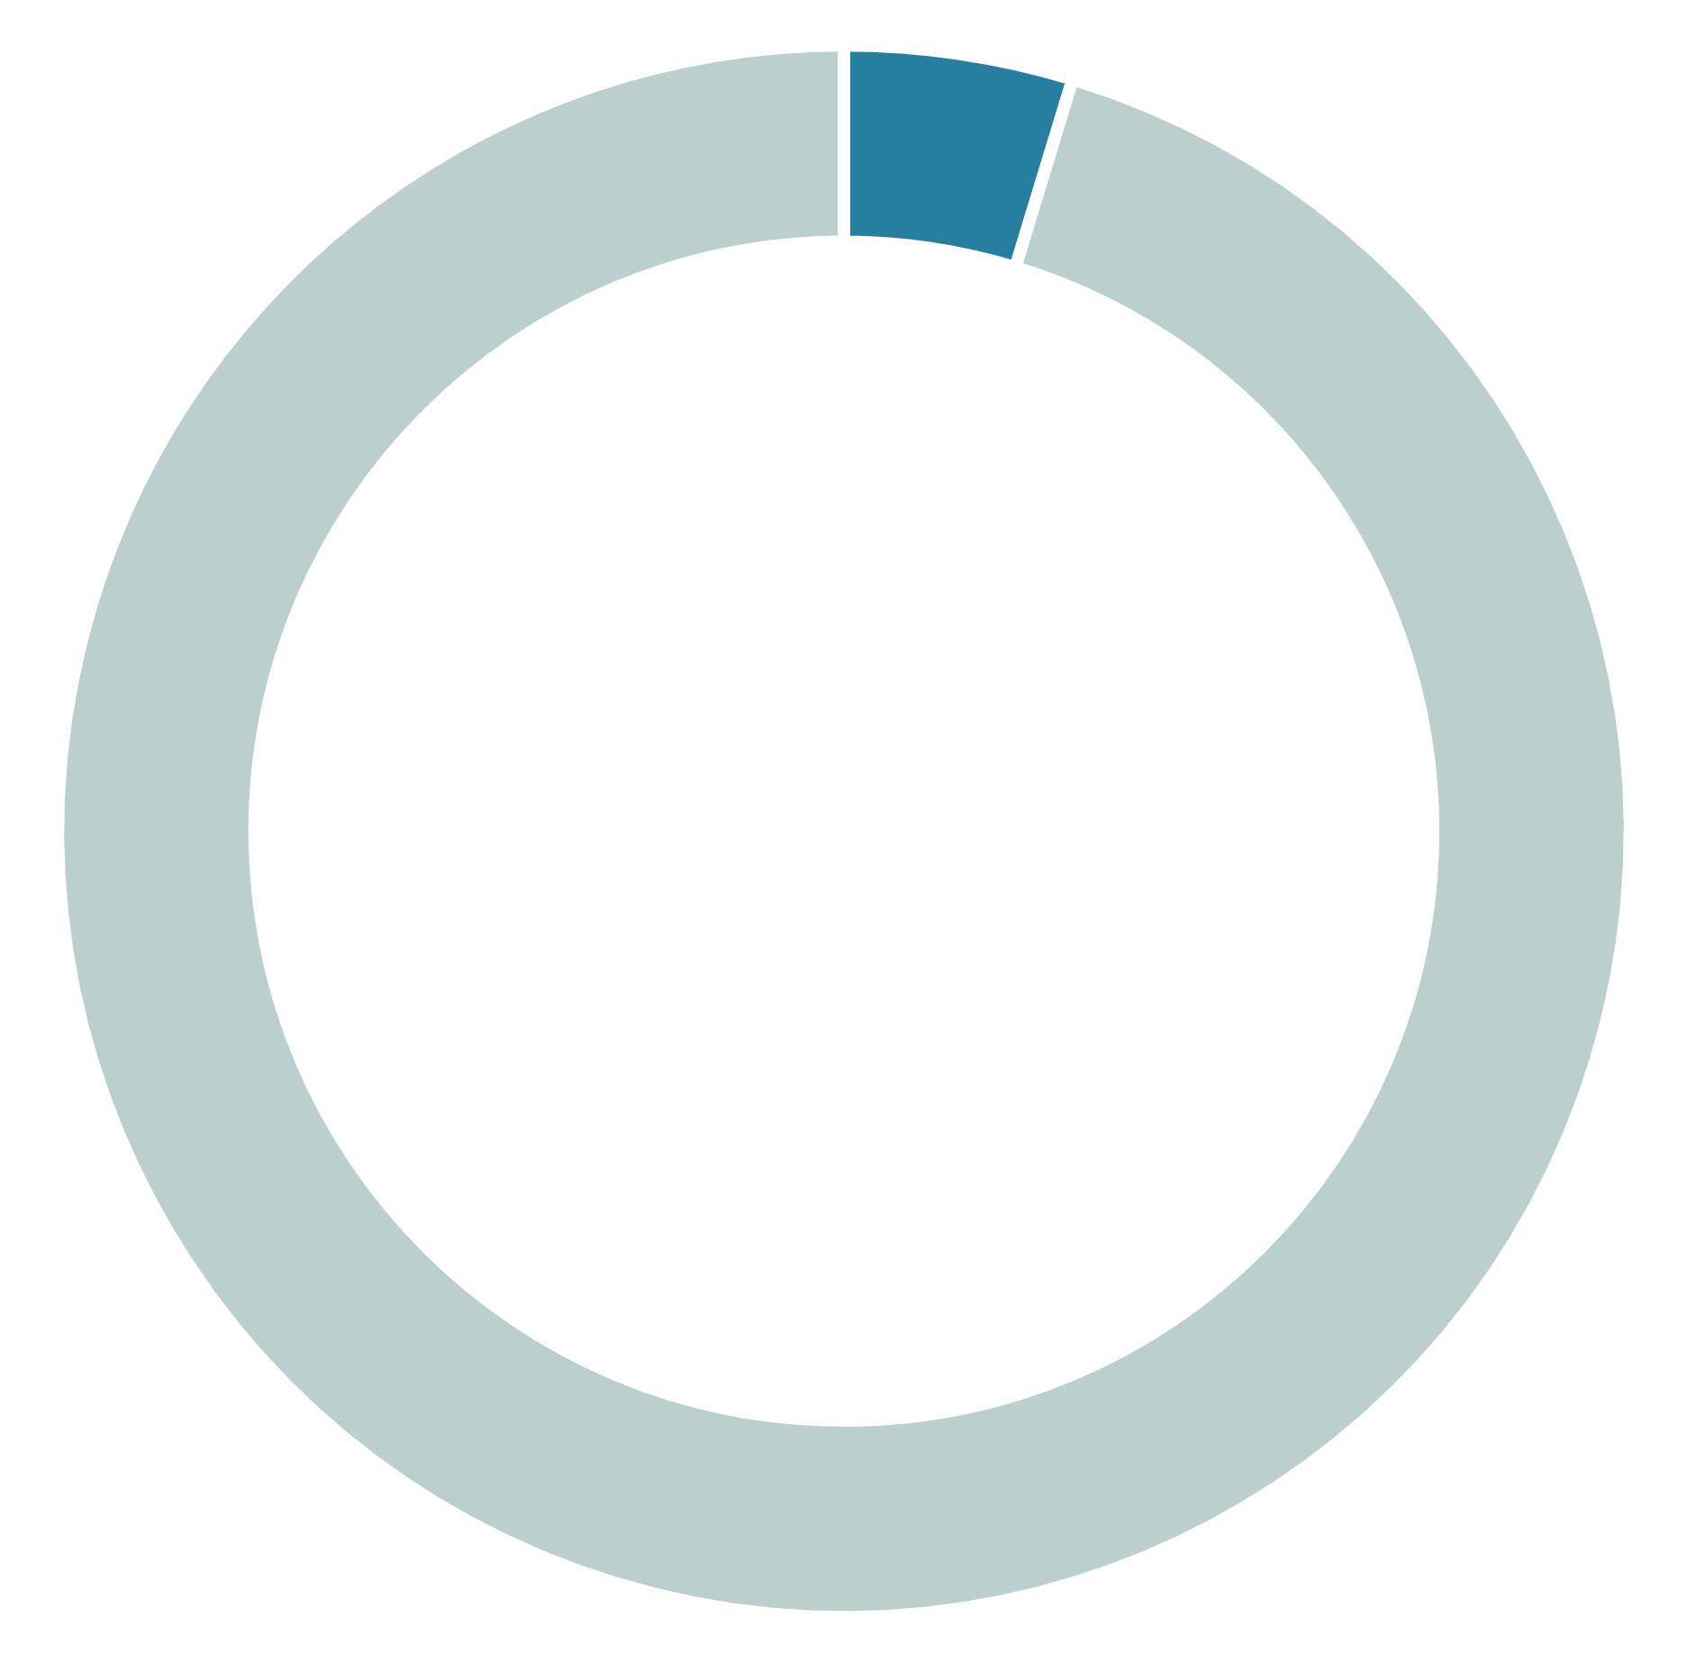
For the first time ever, we know how many students enrolled in foundational computer science
4.7%
of U.S. high school students enrolled in CS

Slide 13
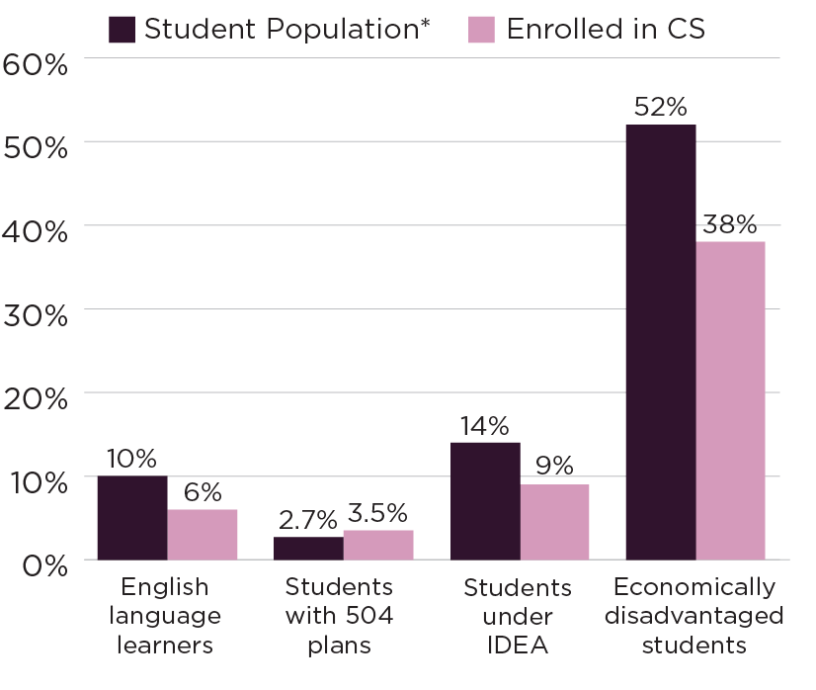
There are still gaps in student representation in courses
English language learners, students with disabilities, and economically disadvantaged students are underrepresented in computer science compared to their state populations.

Slide 14
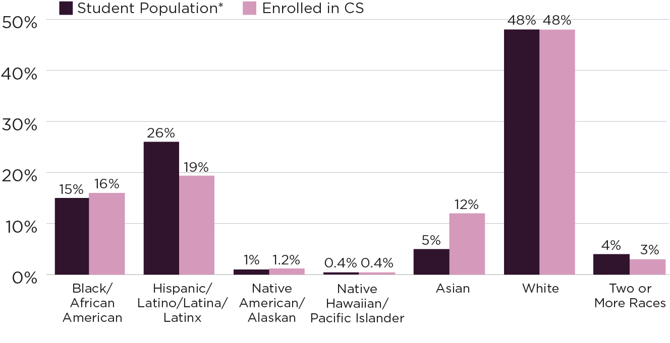
Hispanic/Latinx Students Are Underrepresented

Slide 15
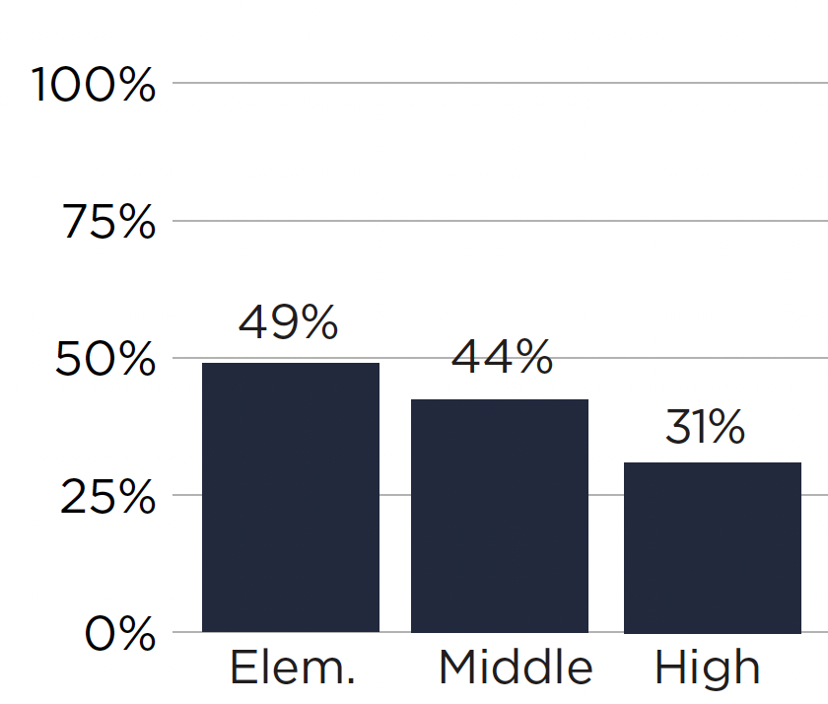
Elementary computer science classes have gender parity
49% of students enrolled are female, compared to 31% female students in high school computer science

Slide 16
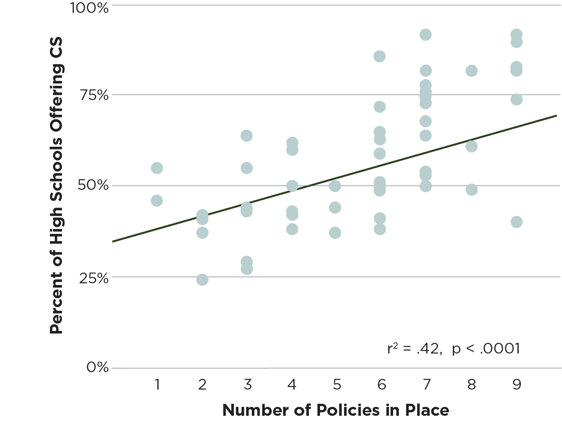
Adoption of computer science policies is correlated with the percentage of high schools offering computer science

Slide 17
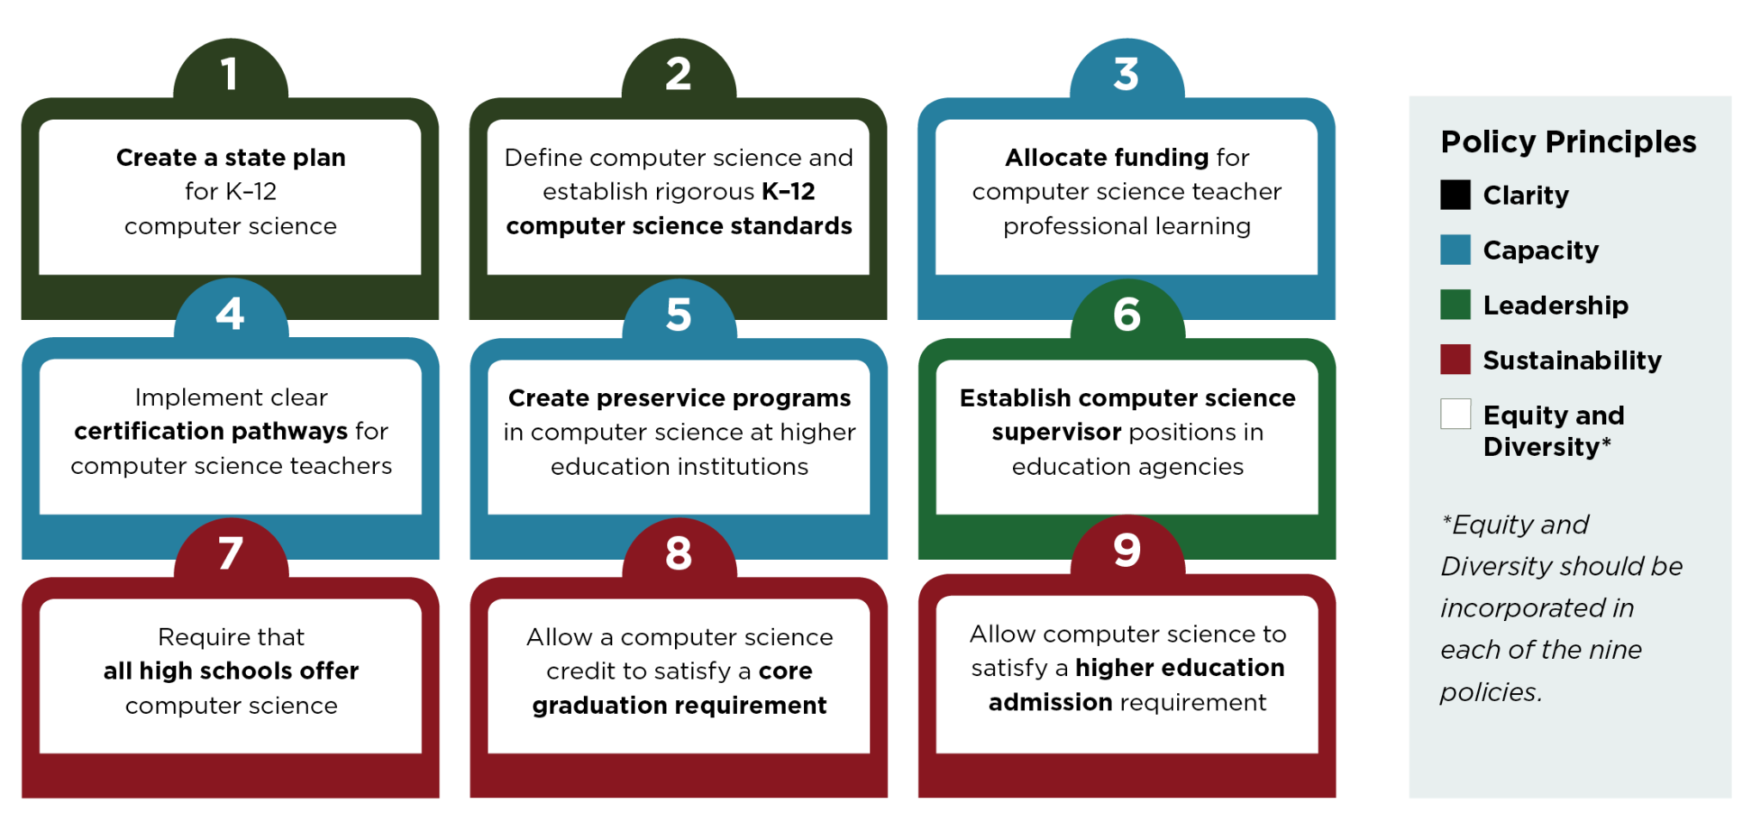
Nine Policies to Make Computer Science Fundamental

Slide 18
Policy Highlights
31 states adopted 50 computer science education policies
All 50 states + DC now allow computer science to count towards a graduation requirement
Three states have a high school graduation requirement in computer science (AR, NV, SC)
AL, AR, ID, IN, MD, NV adopted all nine policies
More than $65M was allocated for FY 2022 across 21 states
23 states require all high schools to offer computer science

Slide 19
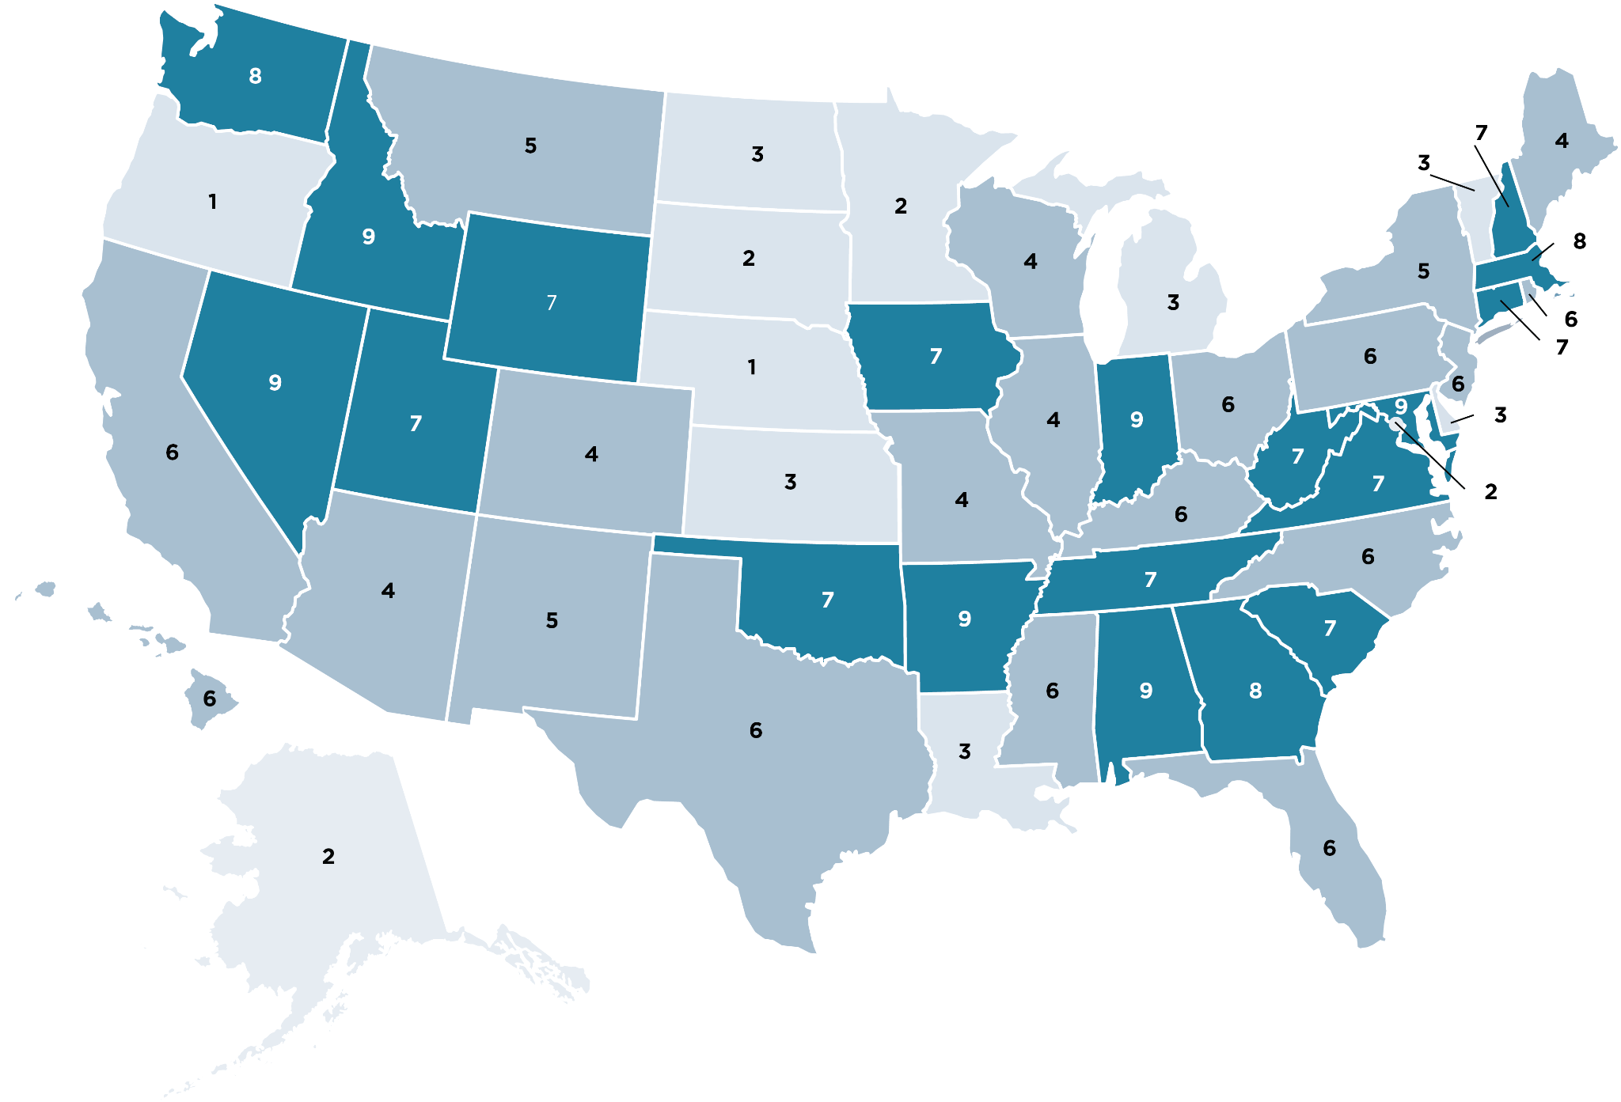
Policies Adopted by State
Based on the nine policies to make CS fundamental

Slide 20
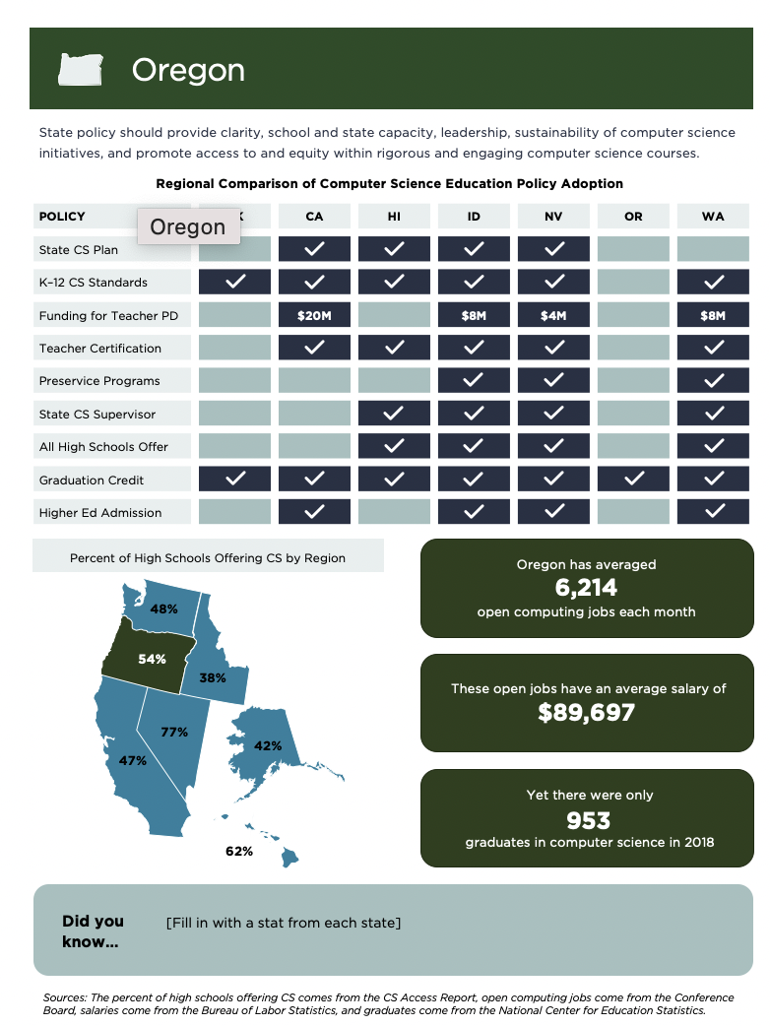
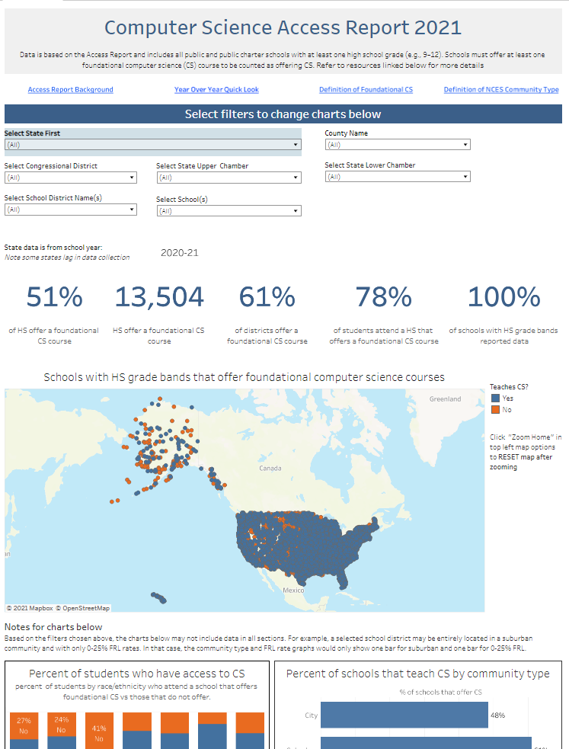
More on the Website,
Launching Nov. 3
State handouts
with regional comparison
Online interactive data visualization
PDF for download
Notes:
share screen and walk through tableau

Slide 21
Rollout
Oct. 27:
Media kit sent to partners
Embargoed pitching to news outlets
Nov. 3:
Embargo lifts
Blog post, tweets
CSEdCon keynote

Slide 22
Data Deep Dive

Slide 23
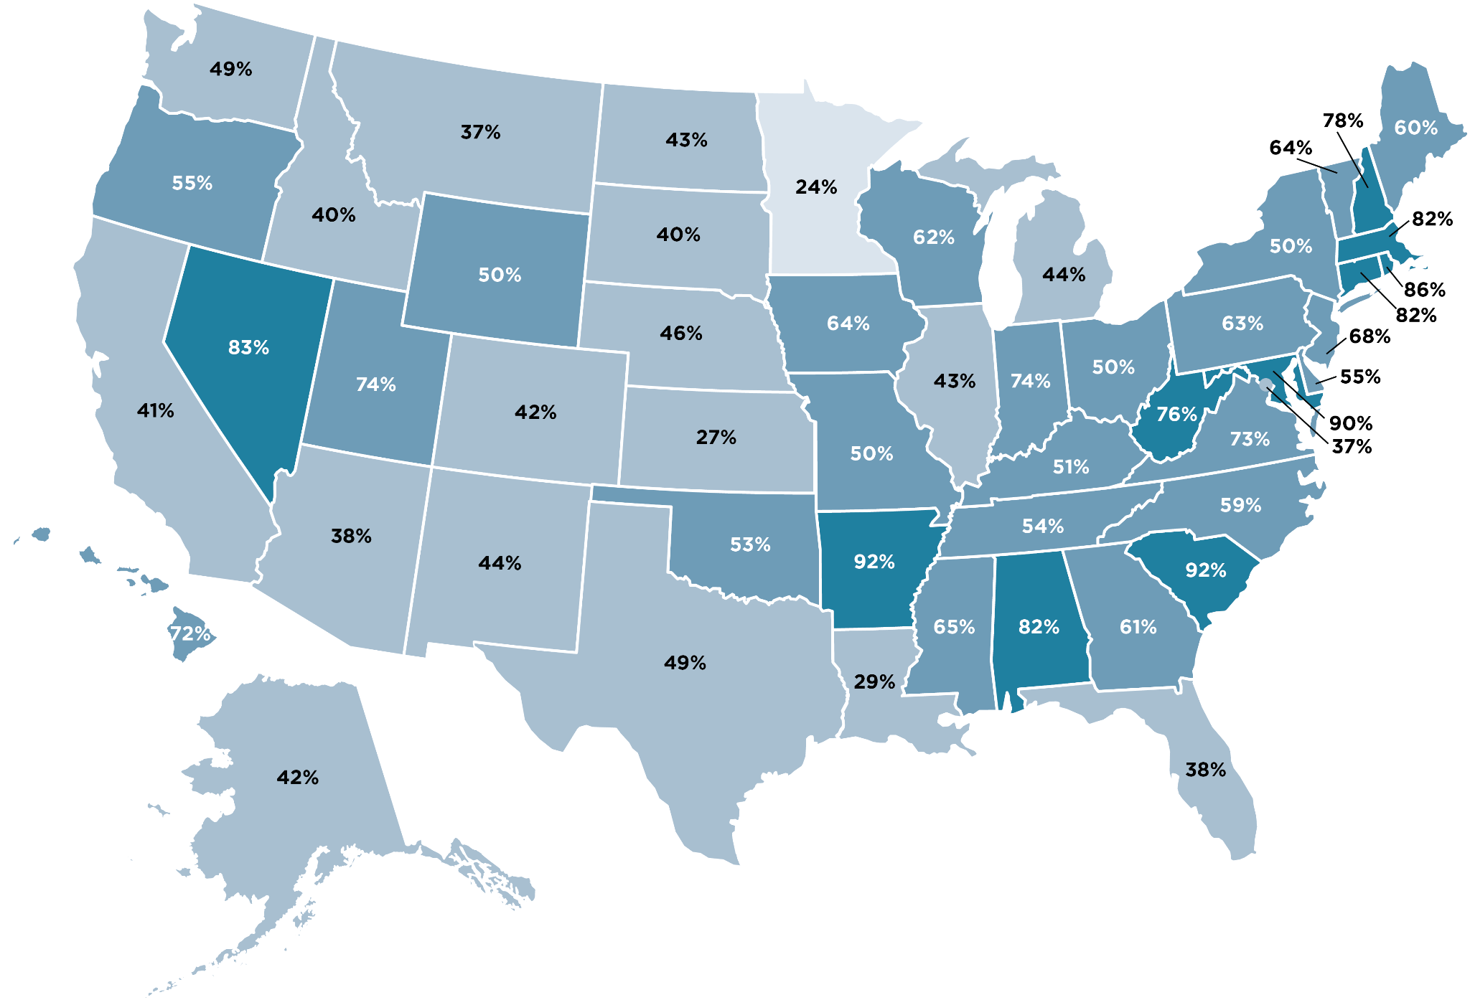
Percent of High Schools Offering Computer Science

Slide 24
Policy Deep Dive

Slide 25
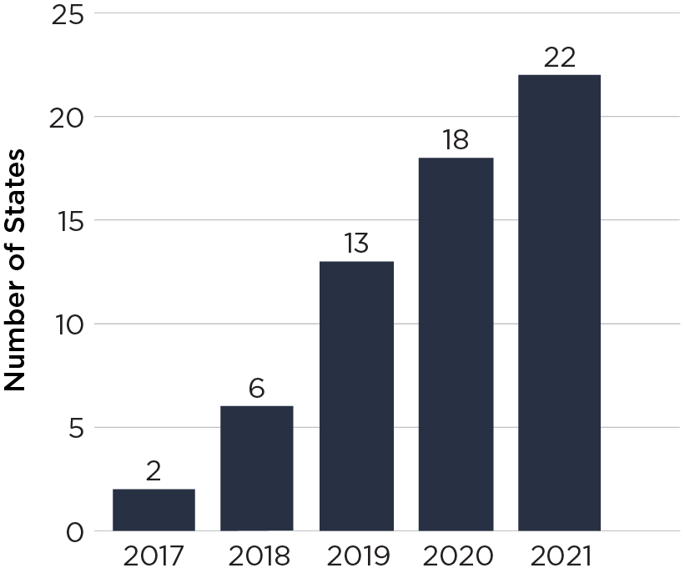
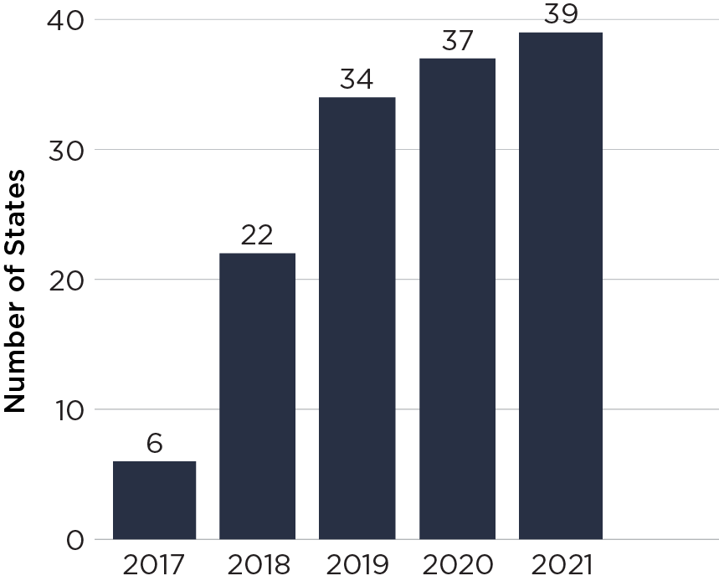
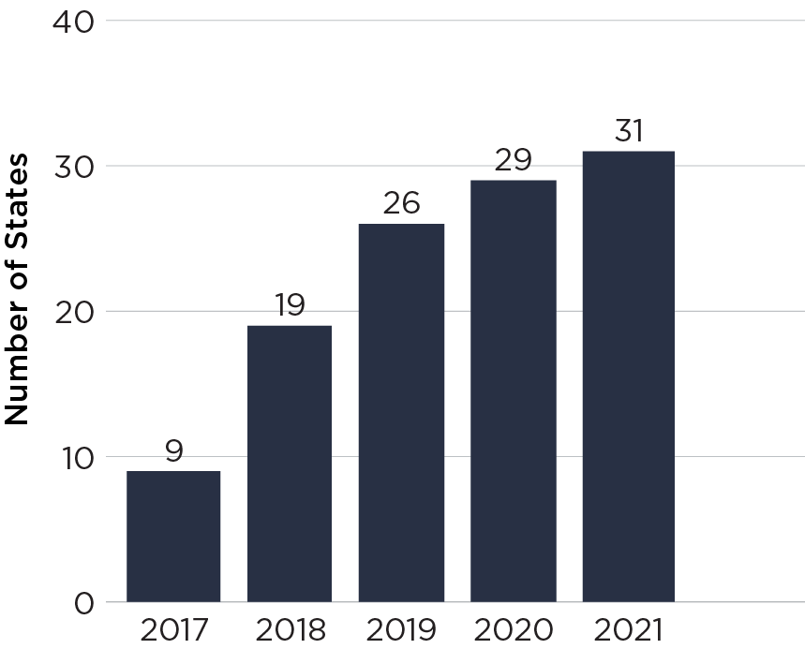
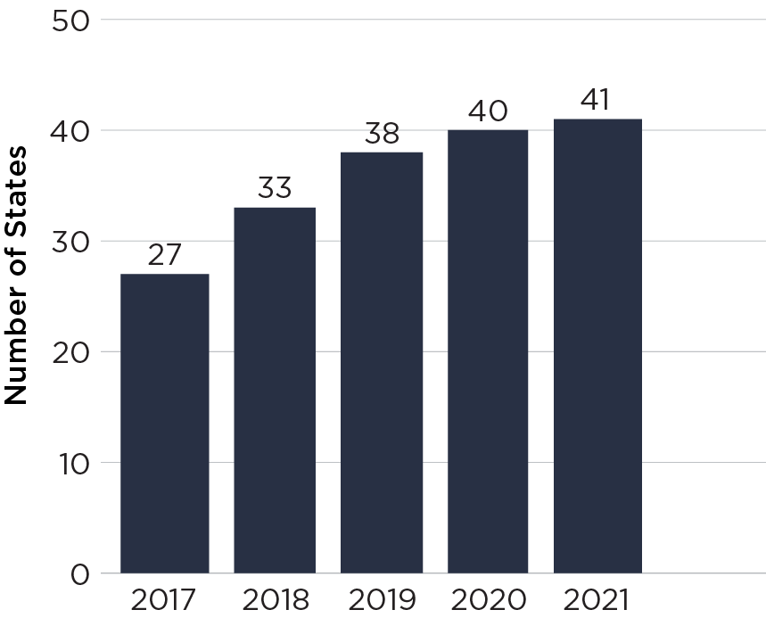
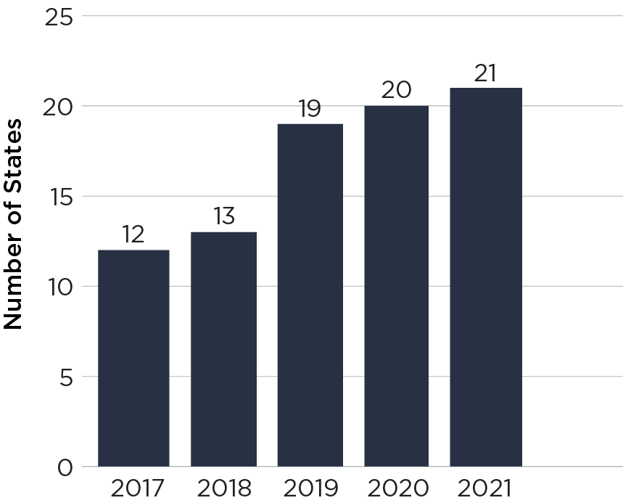
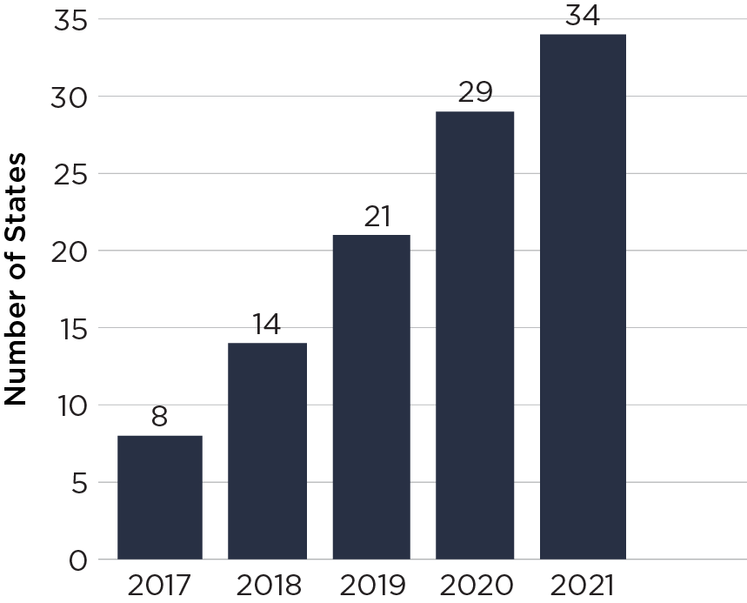
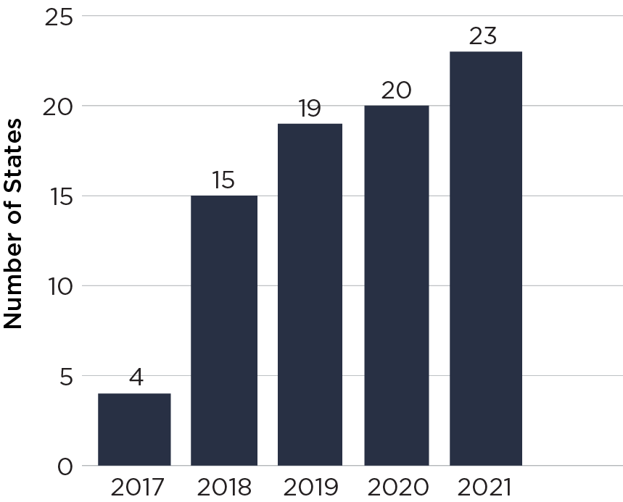
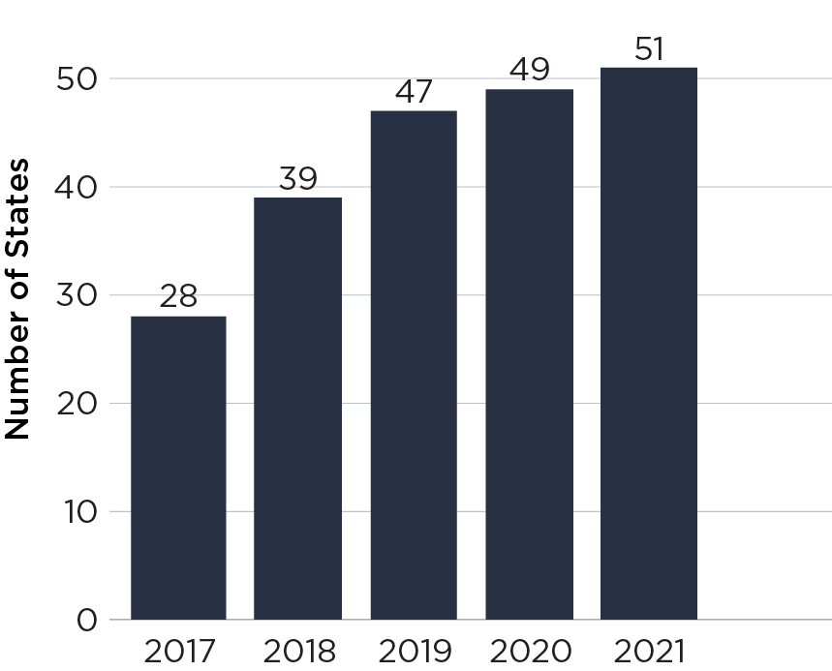
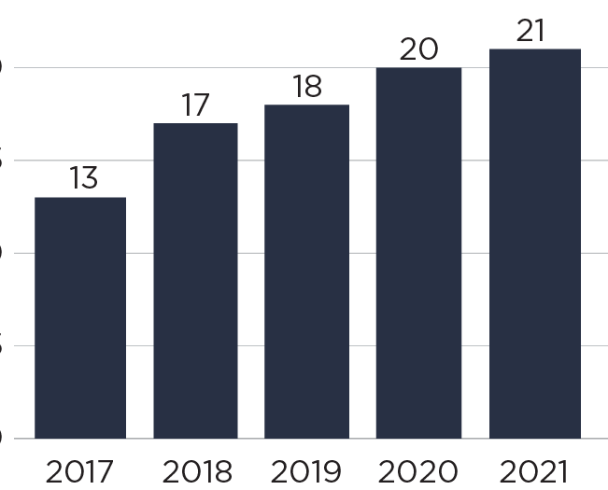
State Policy Progress 2017–2021
1: State Plan
2: Standards
3: Funding
4: Teacher Certification
5: Preservice Programs
6: State CS Supervisor
7: All High Schools
8: Core Grad Credit
9: Higher Ed Admission

Slide 26
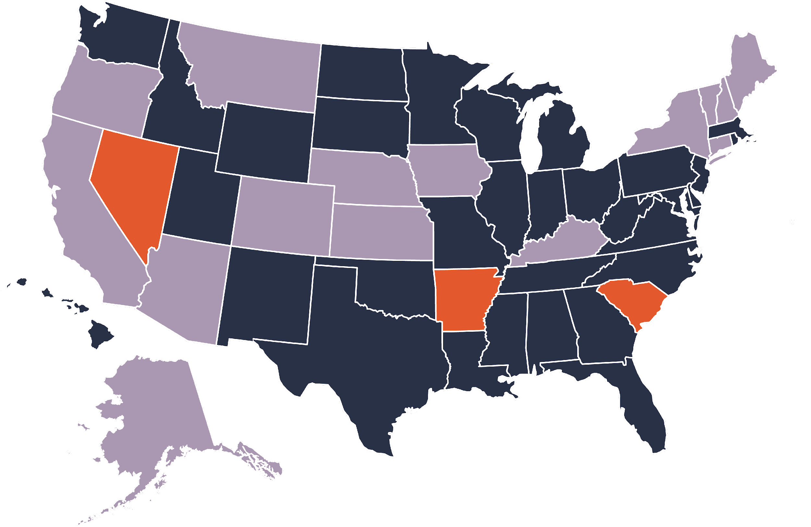
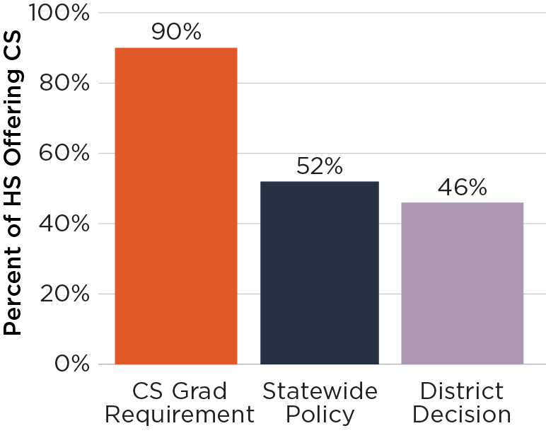
Computer Science Can Satisfy a Core High School Graduation Requirement

Slide 27
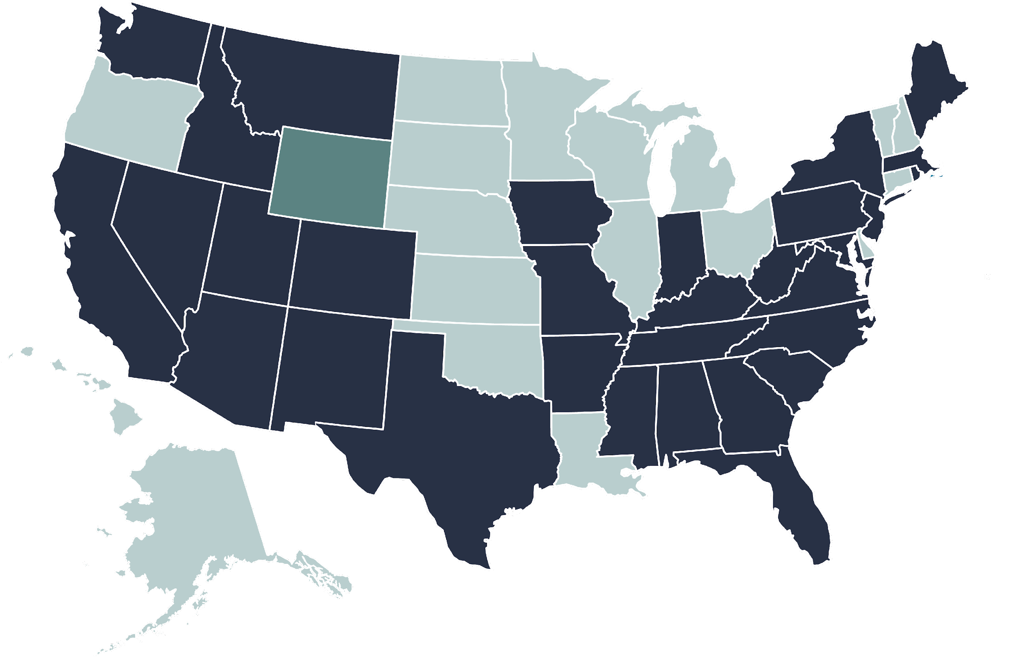
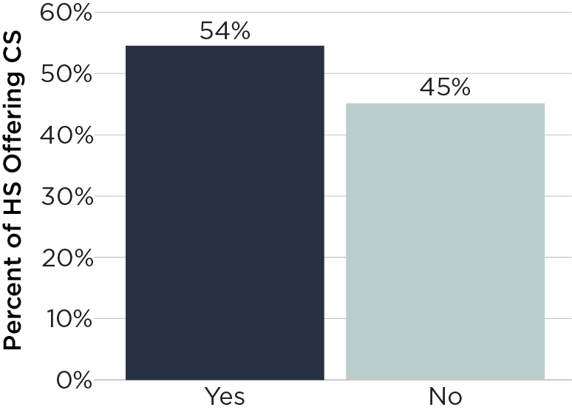
Dedicated Funding for K–12
Computer Science

Slide 28
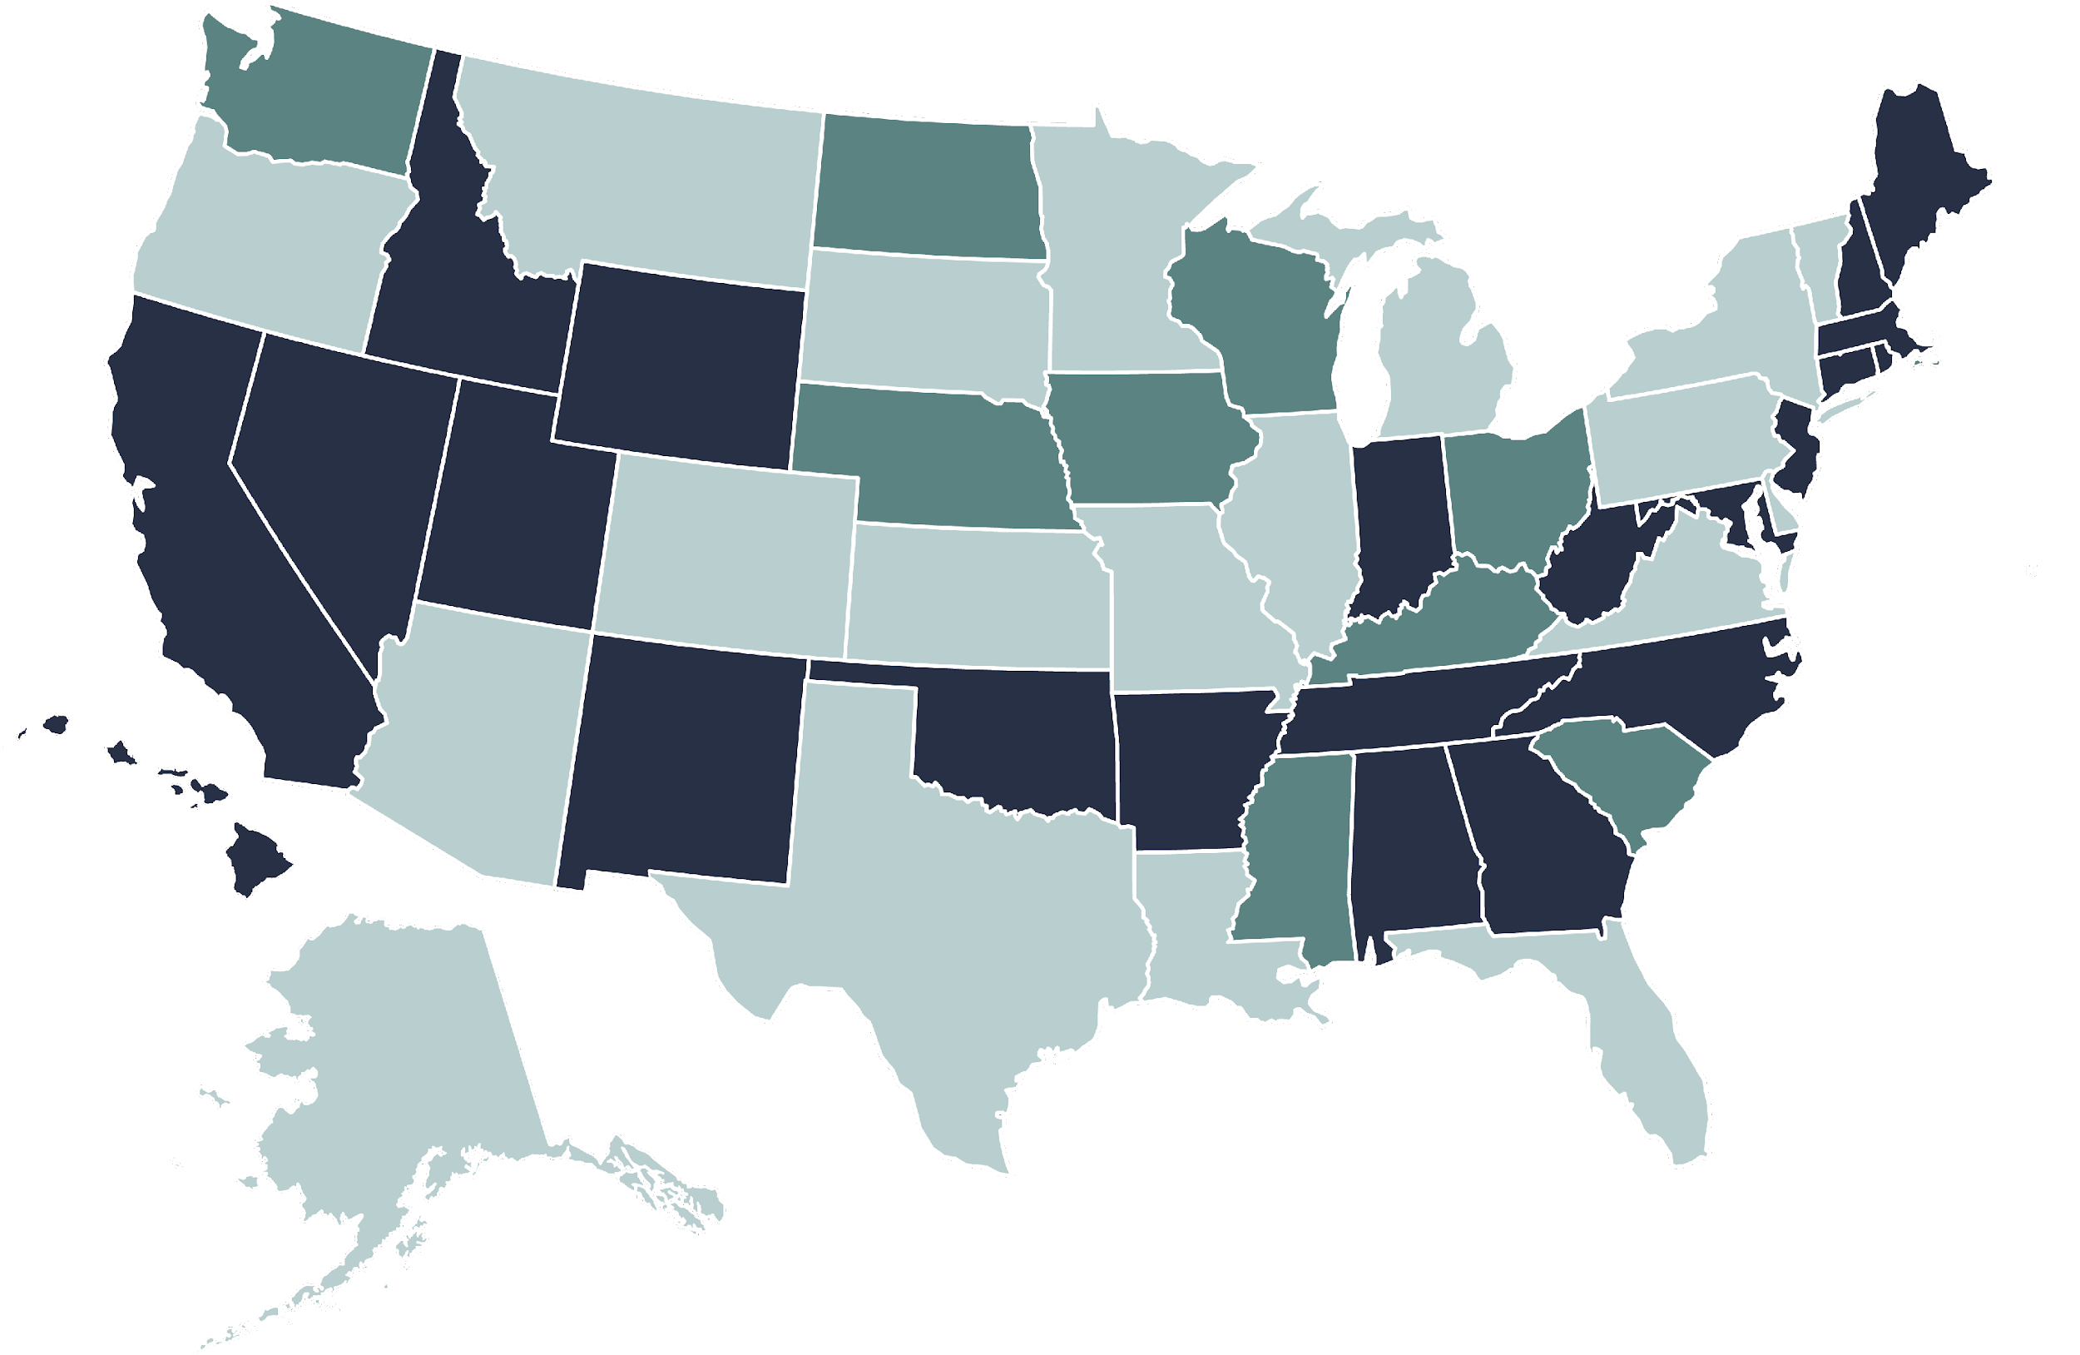
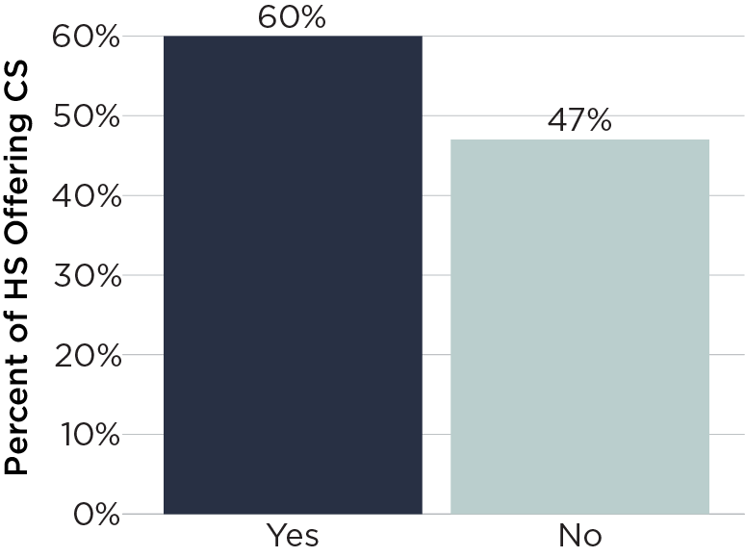
State Plan for K–12 Computer Science

Slide 29
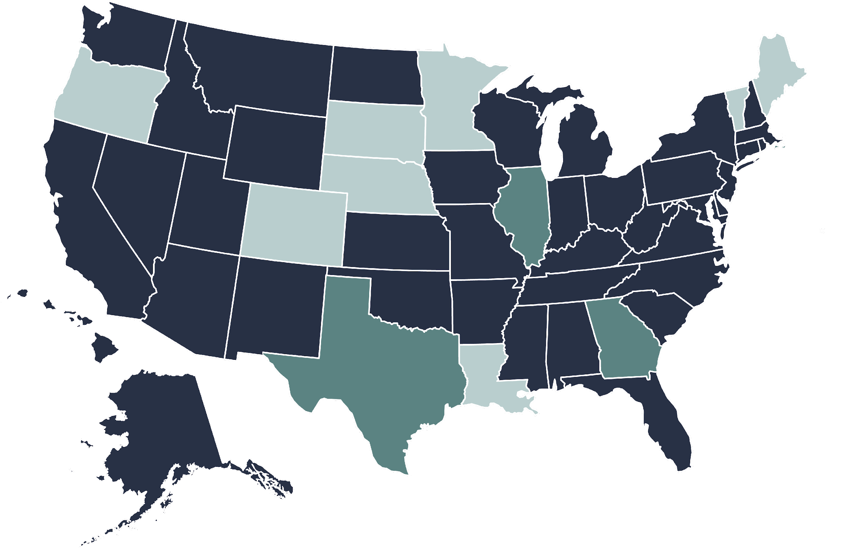
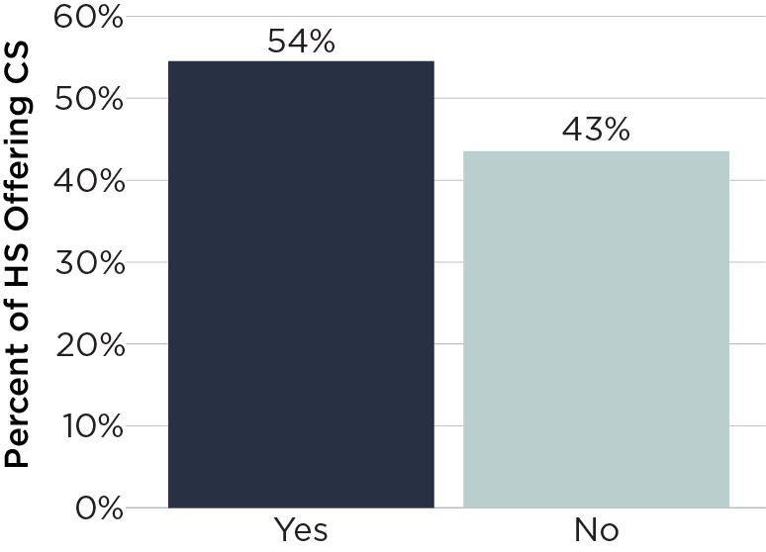
K–12 Computer Science Standards

Slide 30
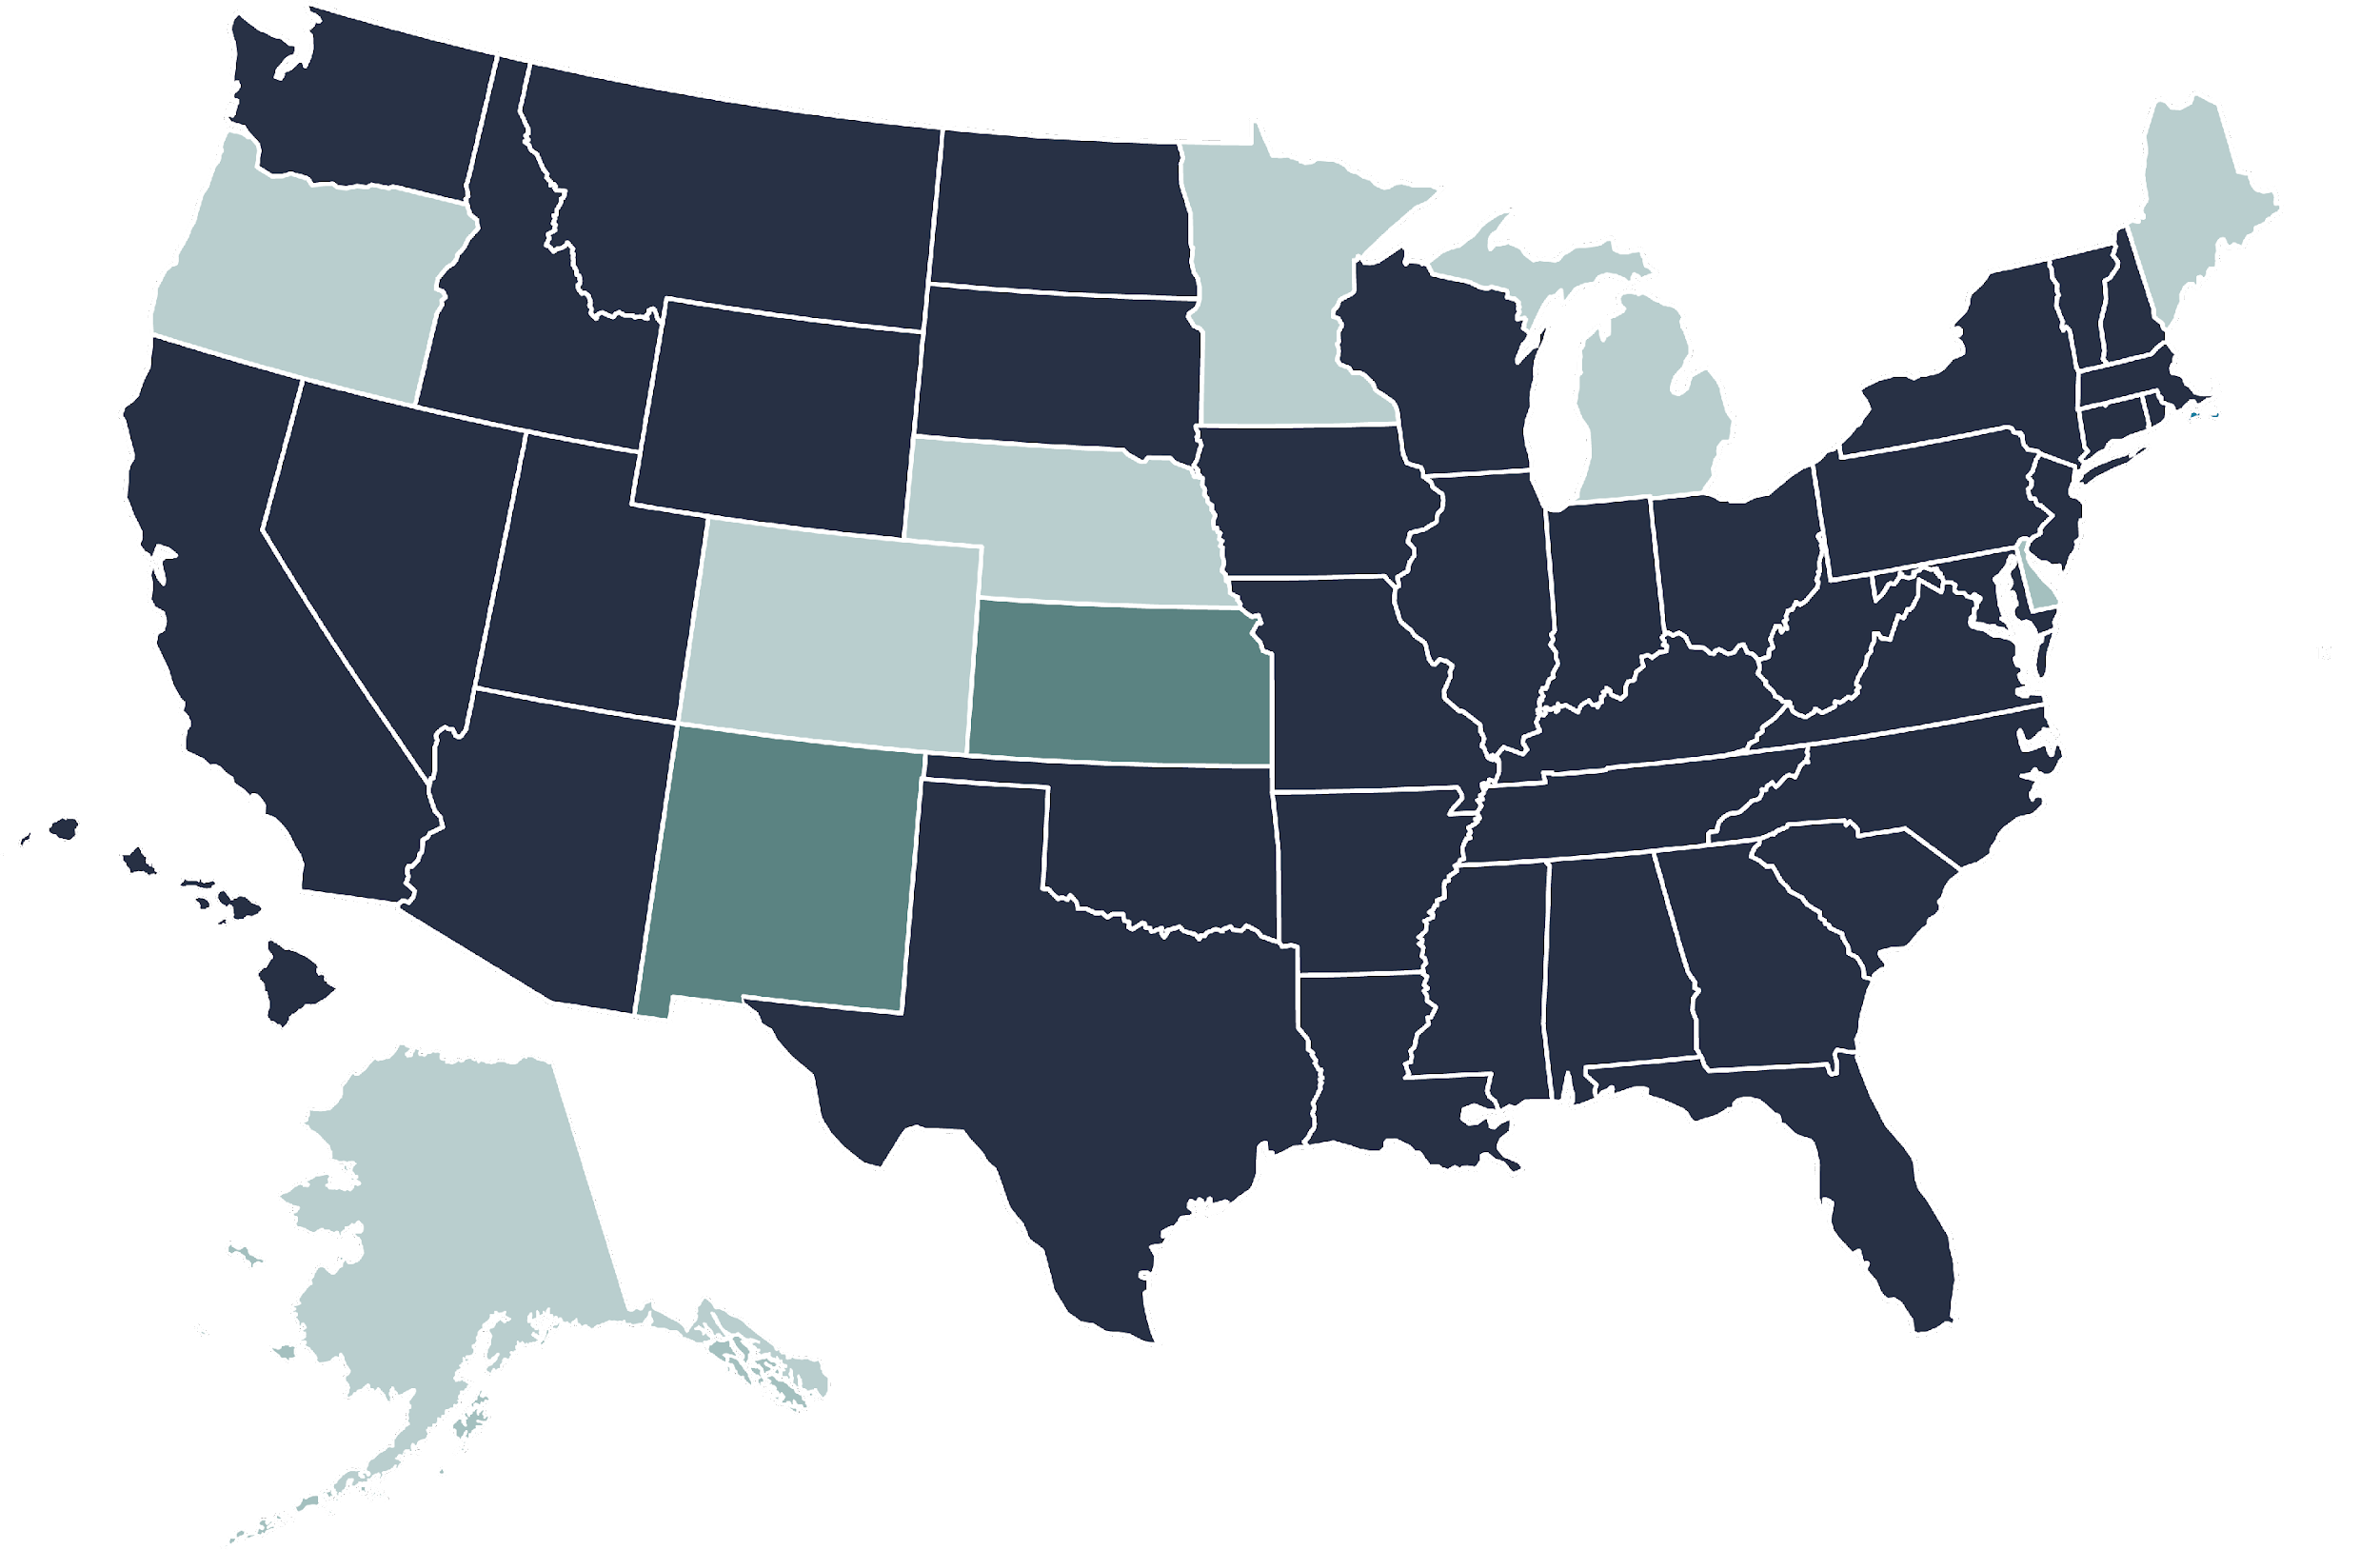
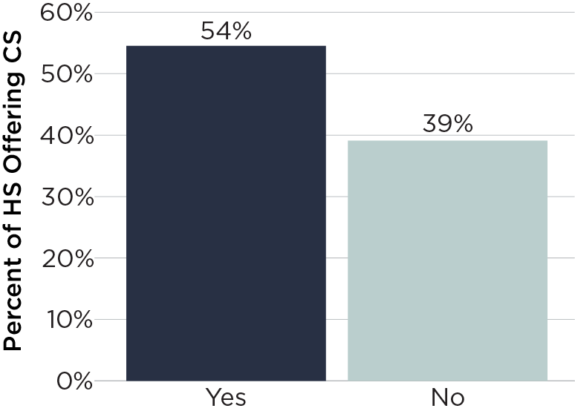
Computer Science Teacher Certification

Slide 31
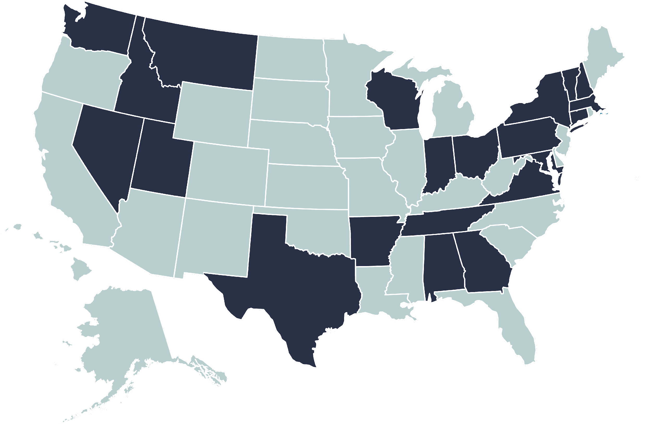
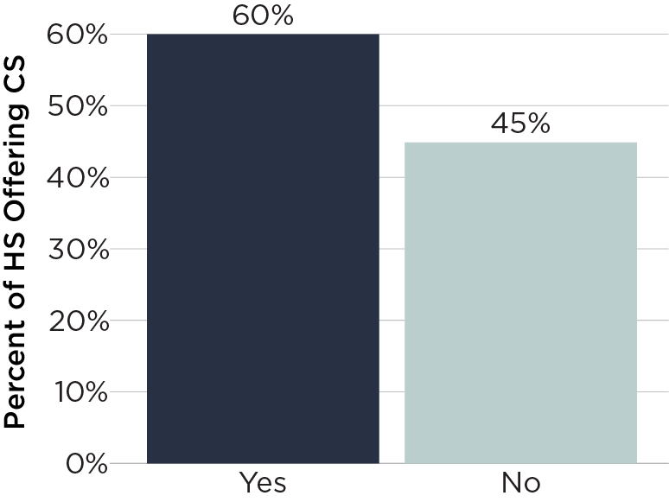
Preservice Programs

Slide 32
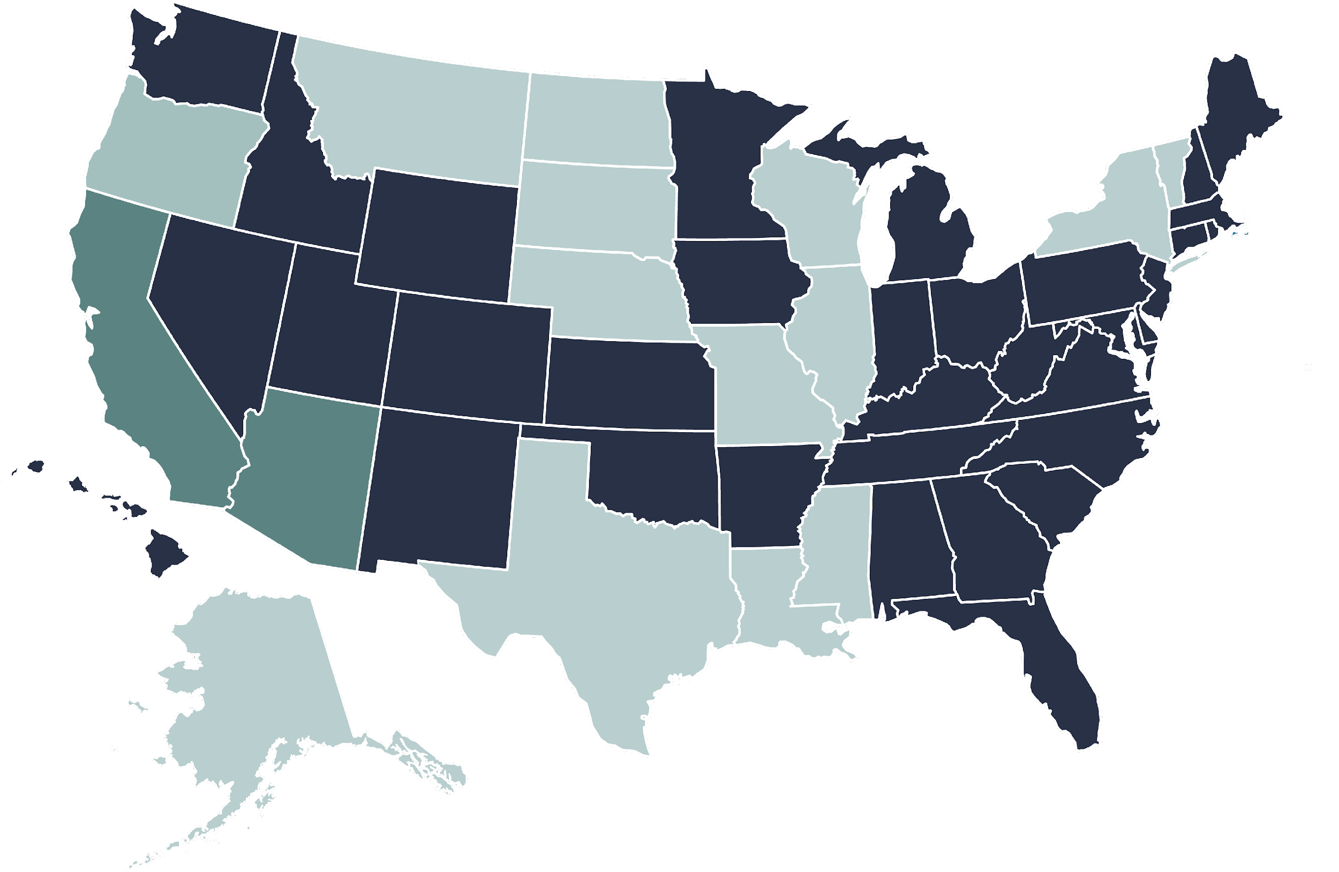
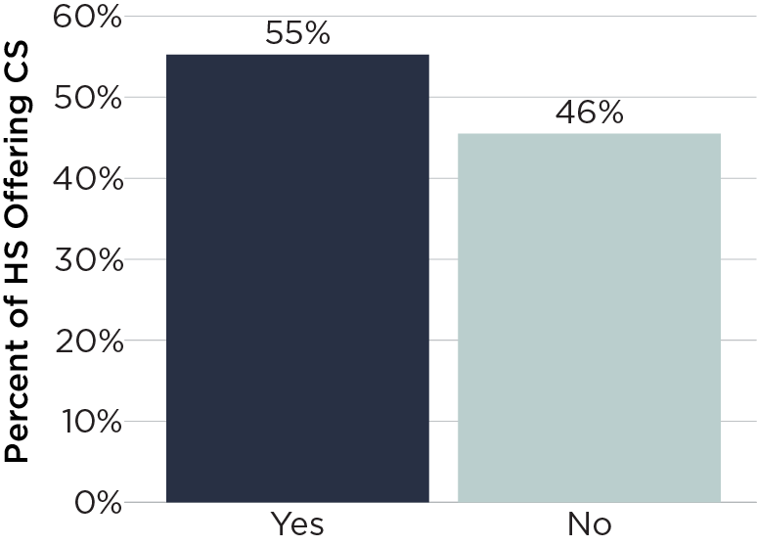
State Computer Science Supervisor

Slide 33
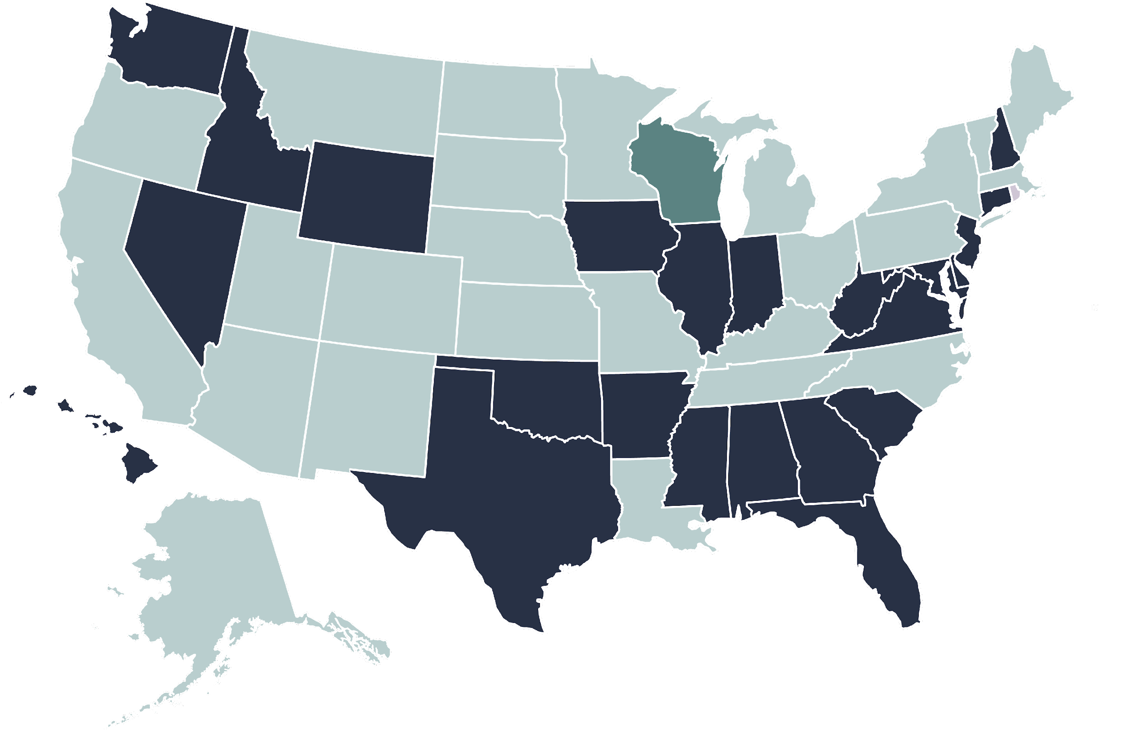
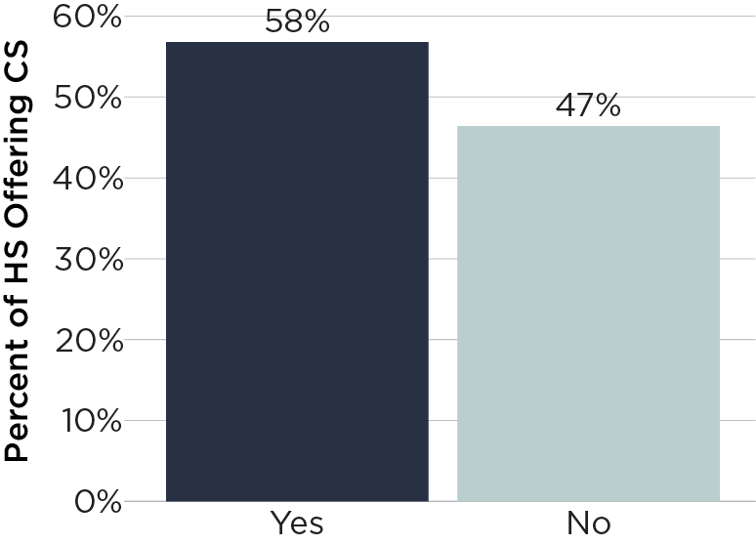
Require All High Schools to Offer

Slide 34
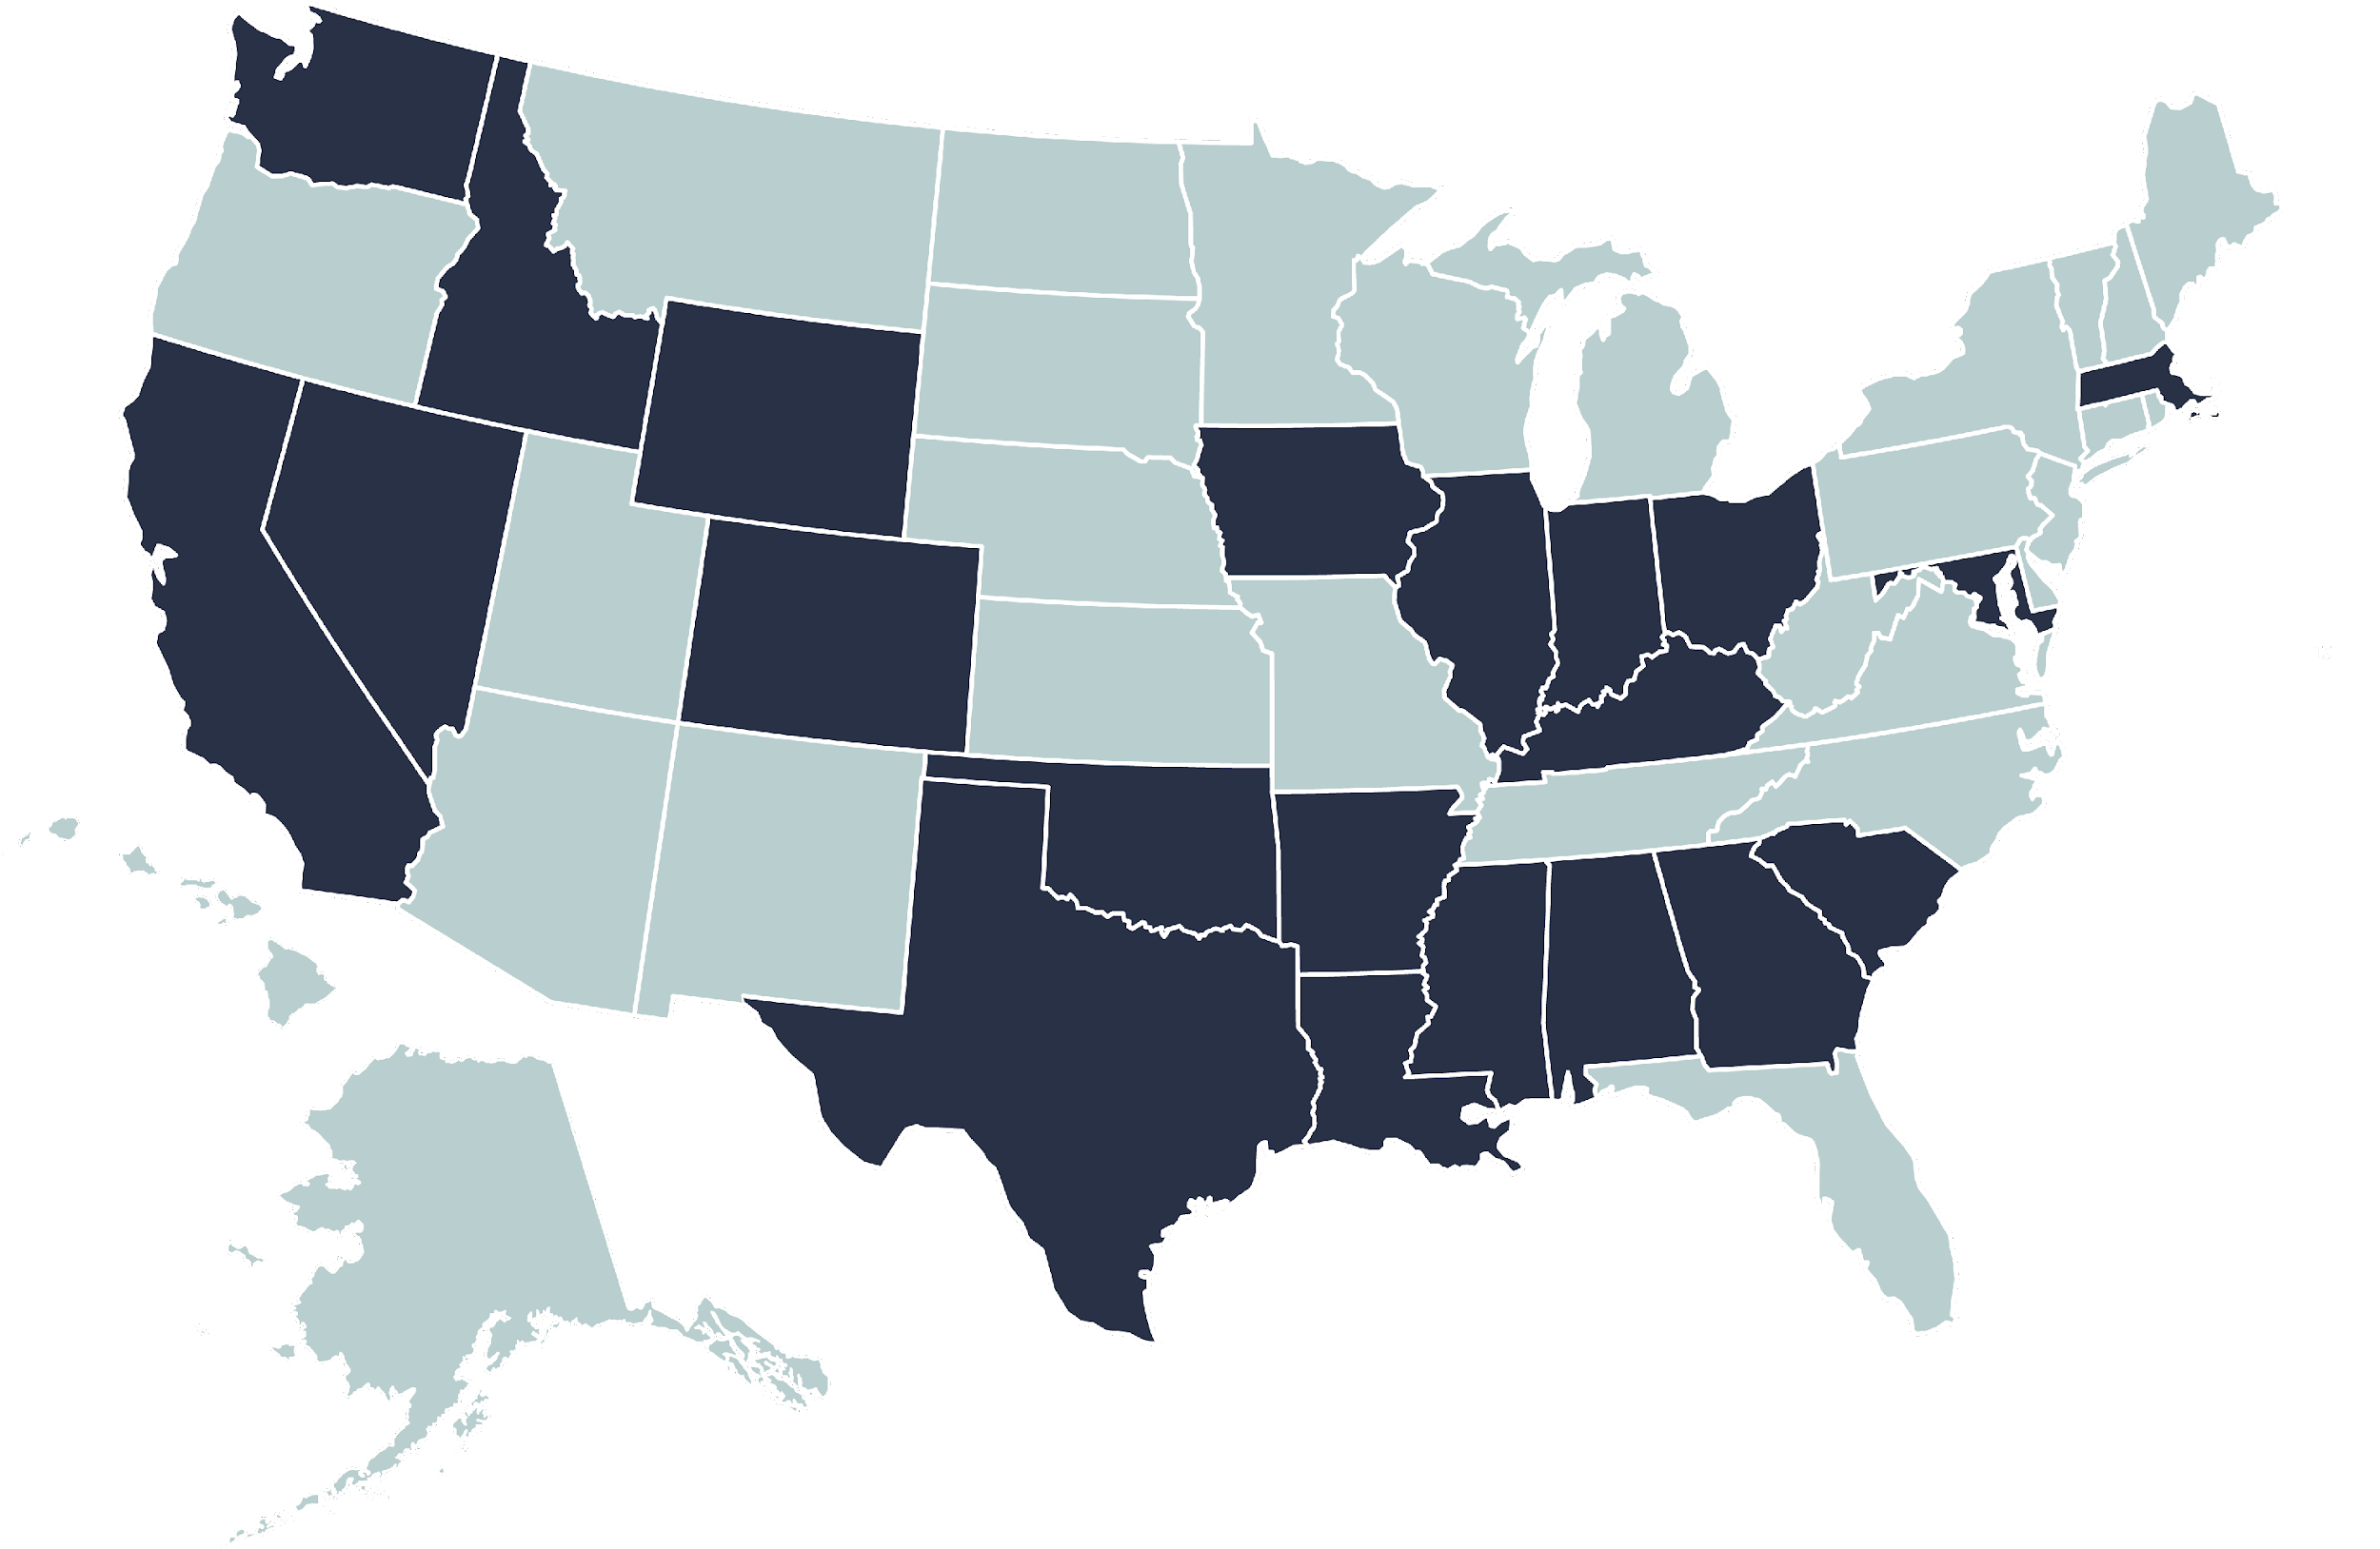
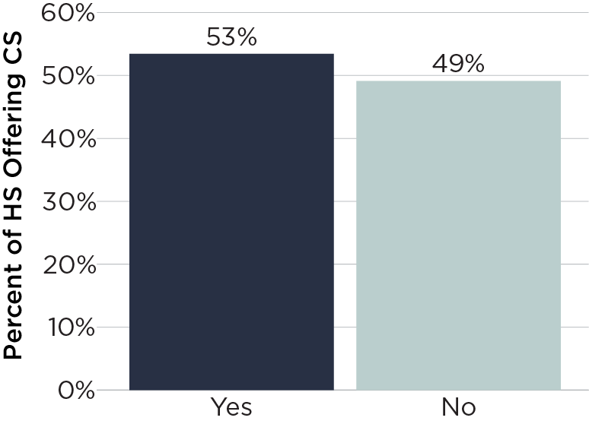
Higher Education Admissions

Slide 35
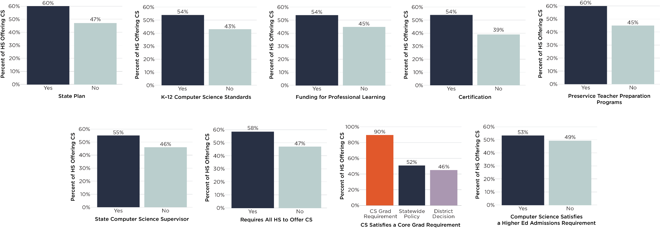
Difference in Access for States With/Without Each Policy

Slide 36
Other Slides

Slide 37
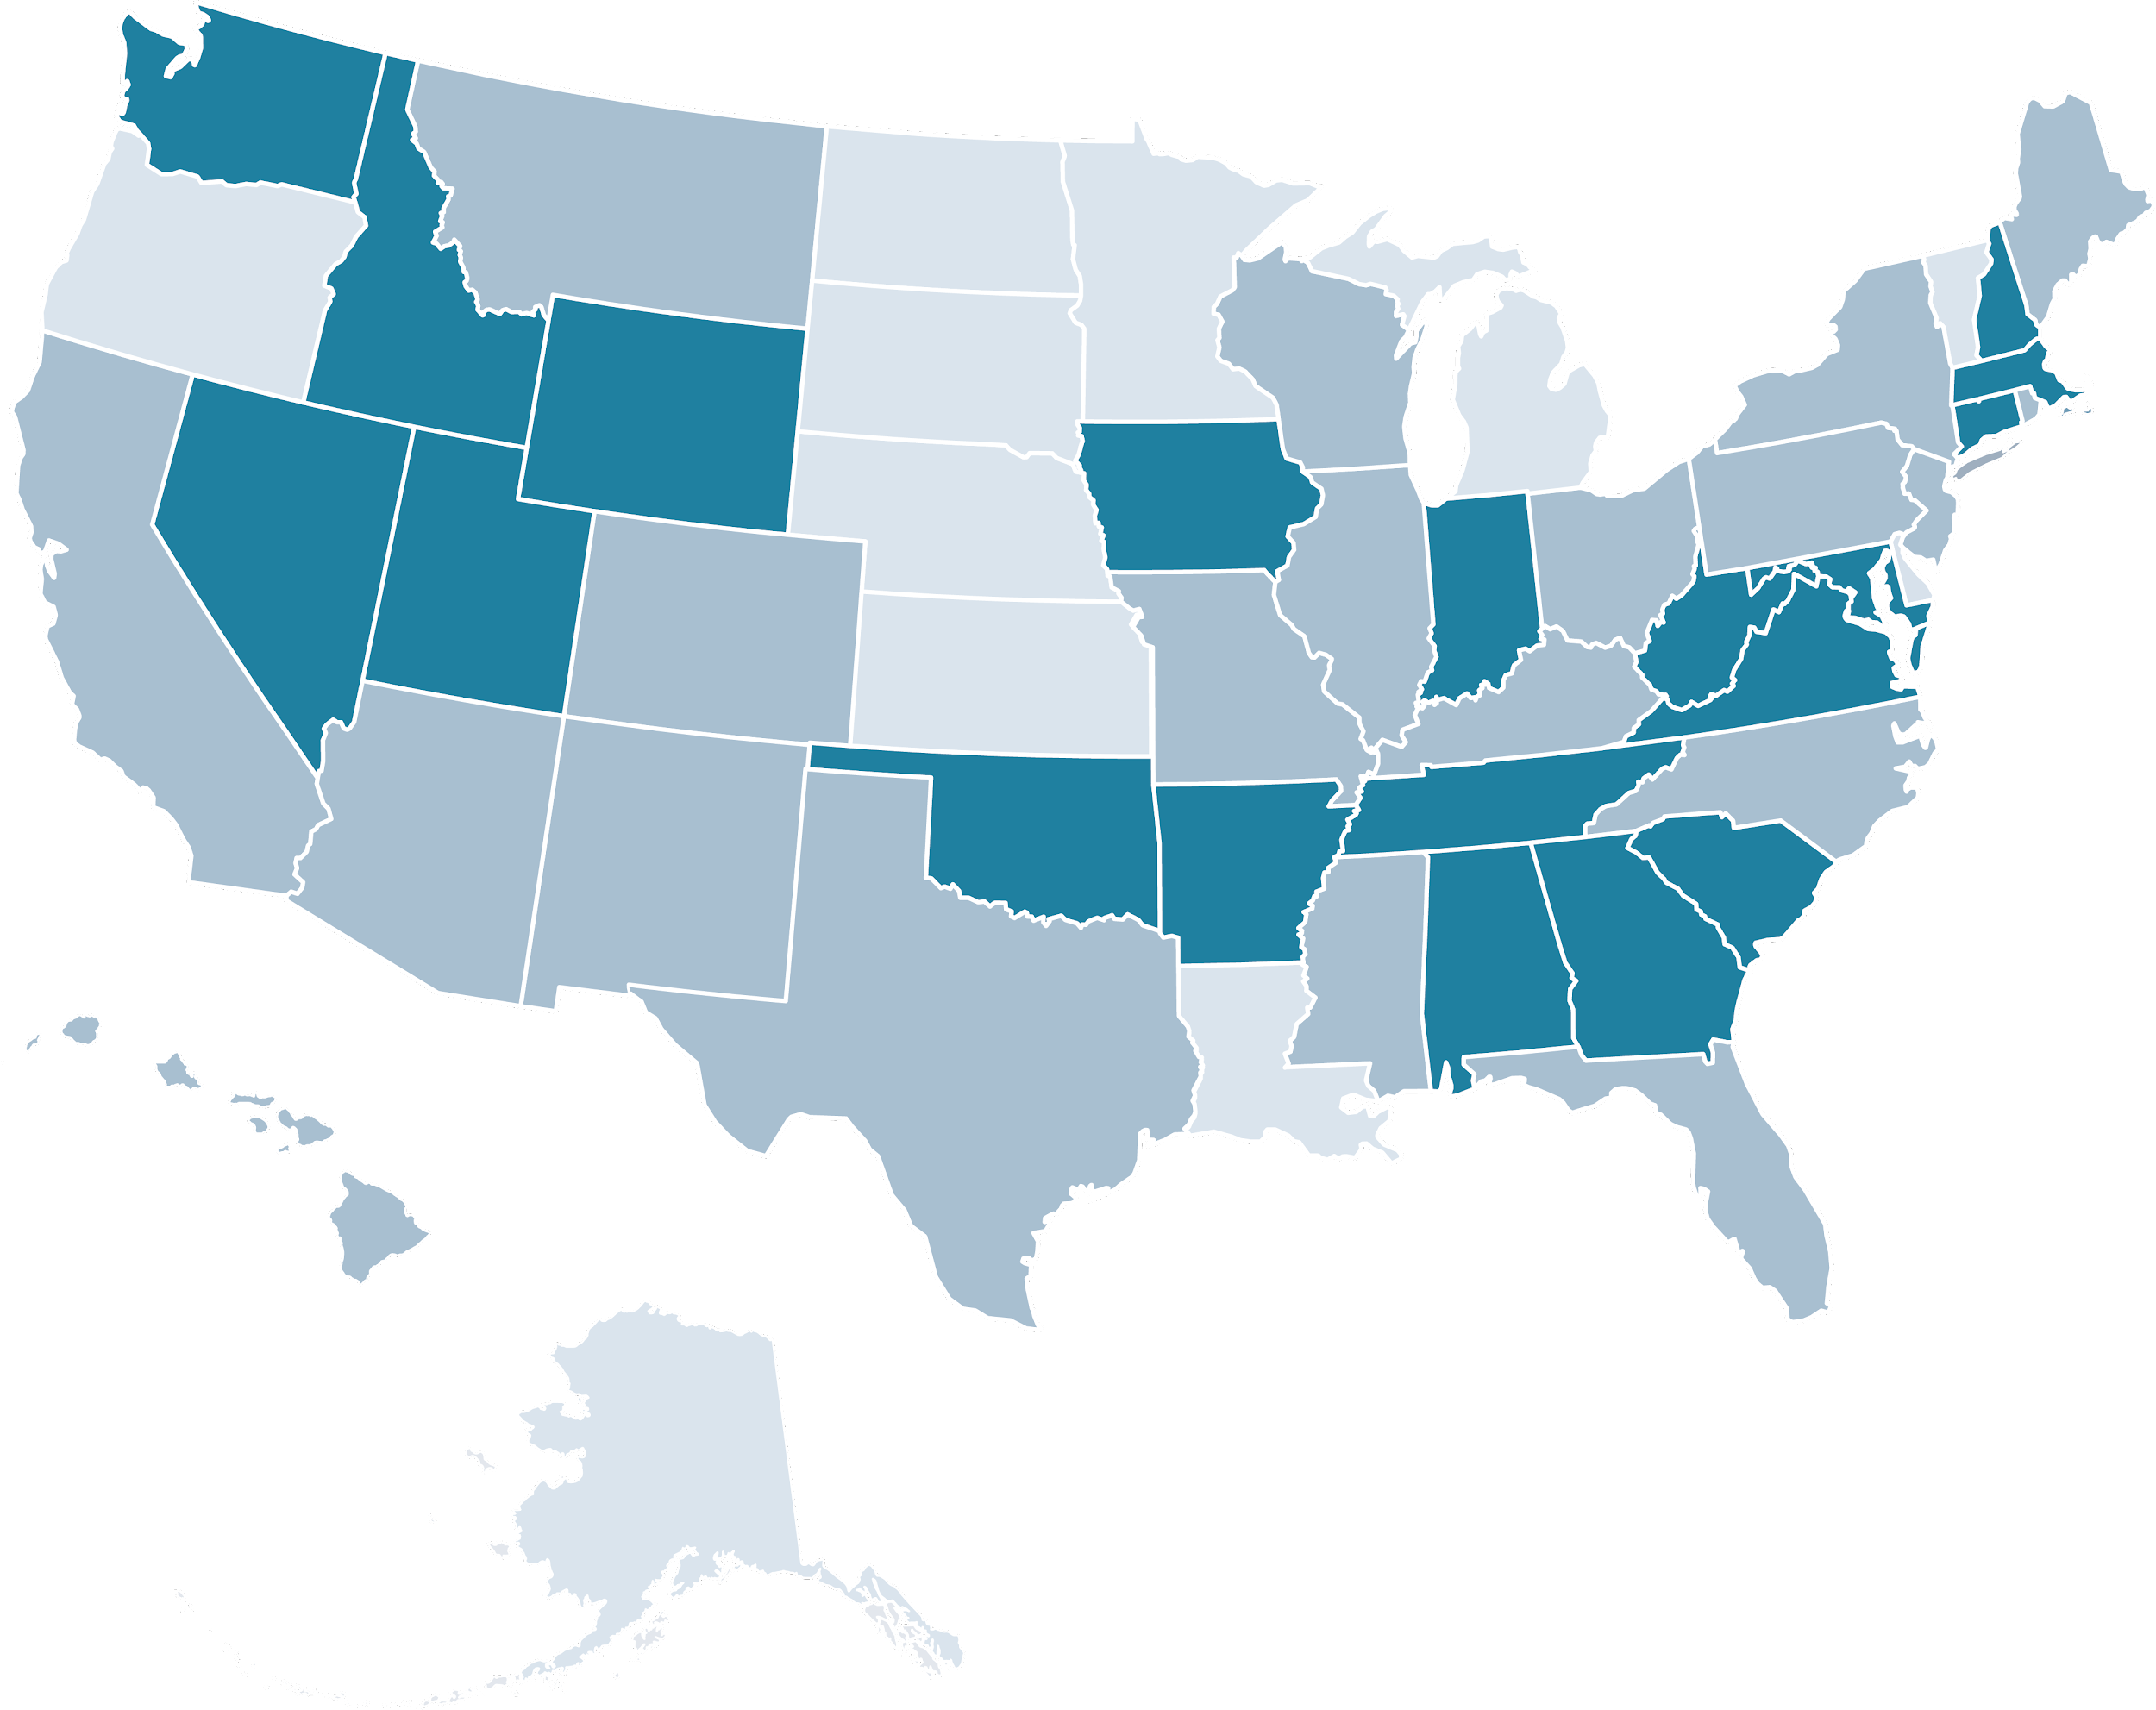
Policies Adopted

Slide 38
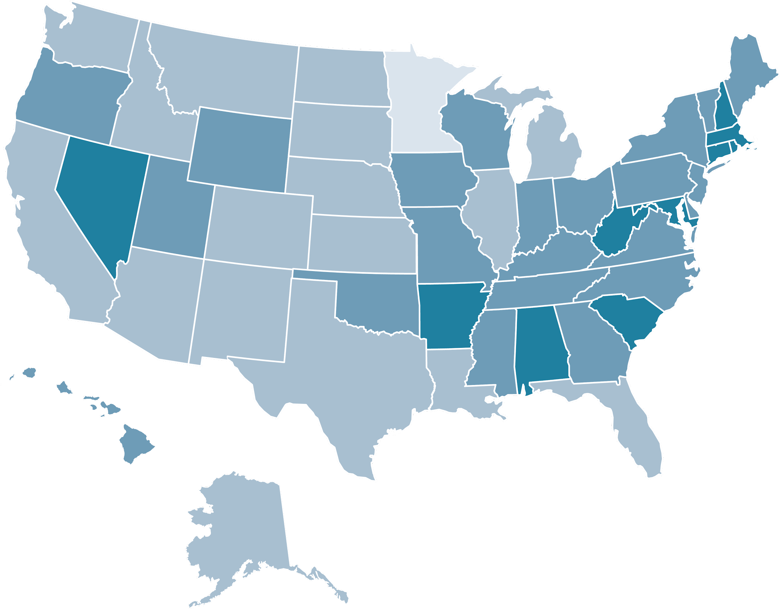
Access to Computer Science

Slide 39
Policies Adopted by State and Access to Computer Science
Number of Policies Adopted
Percent Access to Computer Science

Slide 40
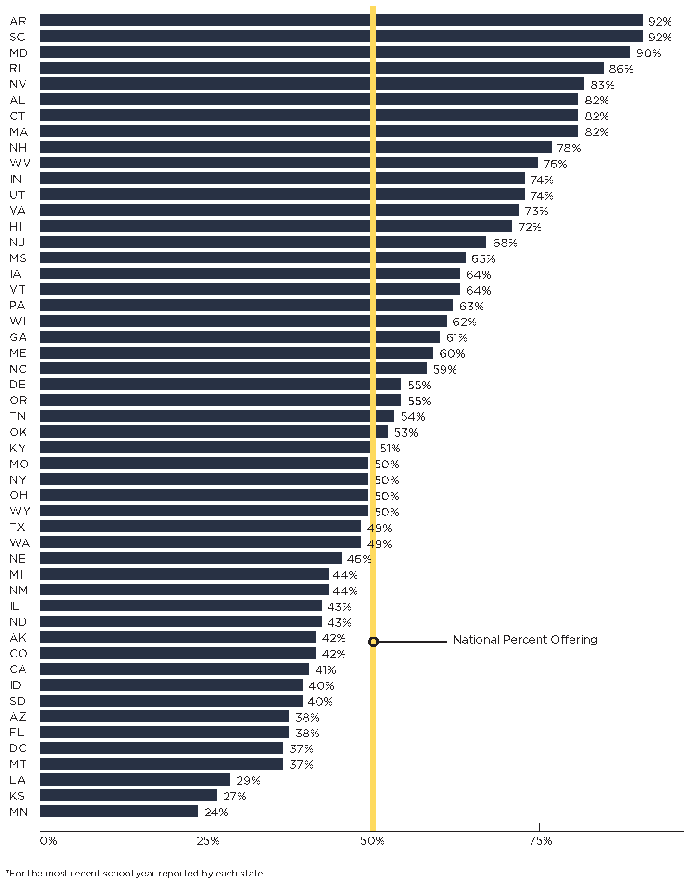
U.S. Schools Offering Computer Science
Percent of Public High Schools

Slide 41
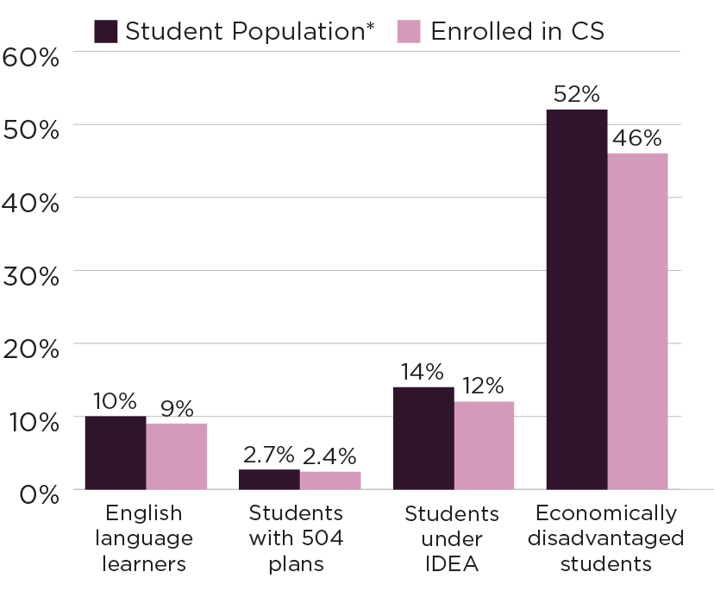
U.S. Student Participation in 6–8 Computer Science by Demographic
*National K–12 student population compared to grades 6–8 student population across 17 states

Slide 42
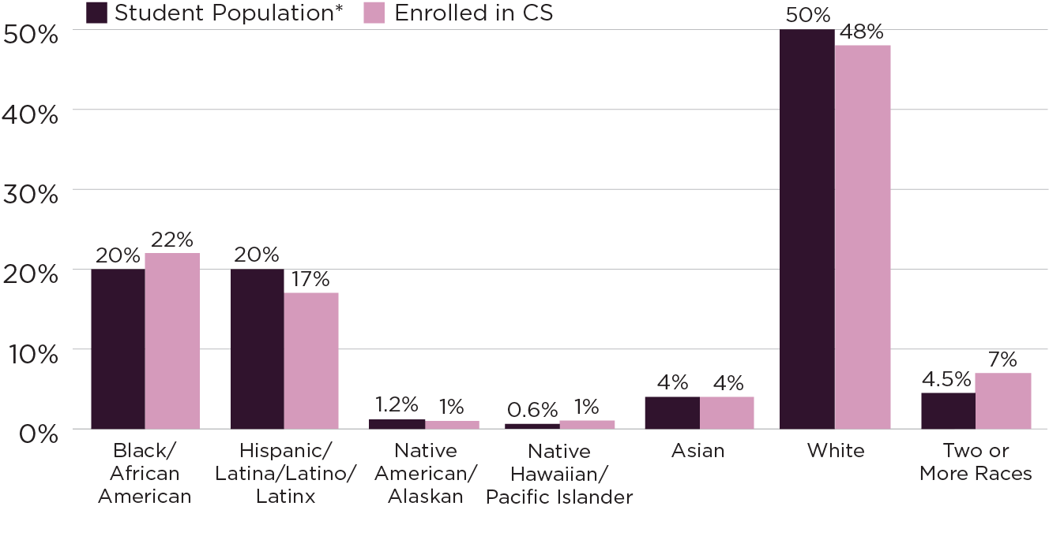
Participation in 6–8 Computer Science by Race/Ethnicity
*Grades 6–8 student population across 17 states

Slide 43

Participation in K–5 Computer Science by Demographic
*National K–12 student population compared to student enrollment across 8 states

Slide 44

Participation in K–5 Computer Science by Race/Ethnicity
*Grades K–5 student population across 8 states

Slide 45

AP Computer Science Exams by Race/Ethnicity (2020)
Page 23
Notes:
2020 exam year. Participation data includes students attending both public and private schools.

Slide 46

AP Computer Science Exams
by Gender (2020)
Page 23
Notes:
2020 exam year. Participation data includes students attending both public and private schools.

Slide 47

AP Computer Science Exams by Gender and Race/Ethnicity (2020)
Page 24
* Expected Population Per Gender is based on the overall enrollment by race/ethnicity at schools that offer AP CS.
* Participation data includes students attending both public and private schools. For the first time, AP data includes students identifying as another gender. Of students taking AP CS exams who identified as another gender, 16 identified as Black/African American, 45 were Hispanic/Latino/Latina/Latinx, 4 were Native American/Alaskan, none were Native Hawaiian/Pacific Islander, 20 were Asian, 133 were white, 14 were two or more races, and 47 provided no response for race/ethnicity.
Notes:
2020 exam year.

Slide 48
State Summaries

Slide 49
Alabama

Slide 50

Alabama
High Schools Offering Computer Science
Percentage Access by School Year

Slide 51

Alabama
High Schools Offering Computer Science
Percentage Access by Geography

Slide 52

Alabama
High Schools Offering Computer Science
Percentage Access by Percent of Students Who Qualify for FRL

Slide 53

Alabama Enrollment in High School Computer Science
Percentage Enrollment by Subgroup

Slide 54

Alabama Enrollment in High School Computer Science
Percentage Enrollment by Race/Ethnicity

Slide 55
Alaska

Slide 56

Alaska High Schools Offering Computer Science
Percentage Access by School Year

Slide 57

Alaska High Schools Offering Computer Science
Percentage Access by Geography

Slide 58

Alaska High Schools Offering Computer Science
Percentage Access by Percent of Students Who Qualify for FRL

Slide 59

Alaska
Participation in AP Computer Science
Percentage of Exams
by Gender

Slide 60

Alaska Participation in
AP Computer Science
Percentage of Exams by Race/Ethnicity

Slide 61
Arizona

Slide 62

Arizona High Schools Offering Computer Science
Percentage Access by School Year

Slide 63

Arizona High Schools Offering Computer Science
Percentage Access by Geography

Slide 64

Arizona High Schools Offering Computer Science
Percentage Access by Percent of Students Who Qualify for FRL

Slide 65

Arizona Enrollment in High School Computer Science
Percentage Enrollment by Subgroup

Slide 66

Arizona Enrollment in High School Computer Science
Percentage Enrollment by Race/Ethnicity

Slide 67
Arkansas

Slide 68

Arkansas High Schools Offering Computer Science
Percentage Access by School Year

Slide 69

Arkansas High Schools Offering Computer Science
Percentage Access by Geography

Slide 70

Arkansas High Schools Offering Computer Science
Percentage Access by Percent of Students Who Qualify for FRL

Slide 71

Arkansas Enrollment in High School Computer Science
Percentage Enrollment by Subgroup

Slide 72

Enrollment in High School Computer Science
Percentage Enrollment by Race/Ethnicity

Slide 73
California

Slide 74

California High Schools Offering Computer Science
Percentage Access by School Year
Notes:
*Decrease may be due to course code changes in SY 2017–18

Slide 75

California High Schools Offering Computer Science
Percentage Access by Geography

Slide 76

California High Schools Offering Computer Science
Percentage Access by Percent of Students Who Qualify for FRL

Slide 77

California Participation in AP Computer Science
Percentage of Exams
by Gender

Slide 78

California Participation in
AP Computer Science
Percentage of Exams by Race/Ethnicity

Slide 79
Colorado

Slide 80

Colorado High Schools Offering Computer Science
Percentage Access by School Year

Slide 81

Colorado High Schools Offering Computer Science
Percentage Access by Geography

Slide 82

Colorado High Schools Offering Computer Science
Percentage Access by Percent of Students Who Qualify for FRL

Slide 83

Colorado Participation in AP Computer Science
Percentage of Exams
by Gender

Slide 84

Colorado Participation in
AP Computer Science
Percentage of Exams by Race/Ethnicity

Slide 85
Connecticut

Slide 86

Connecticut High Schools Offering Computer Science
Percentage Access by School Year

Slide 87

Connecticut High Schools Offering Computer Science
Percentage Access by Geography

Slide 88

Connecticut High Schools Offering Computer Science
Percentage Access by Percent of Students Who Qualify for FRL

Slide 89

Connecticut Enrollment in High School Computer Science
Percentage Enrollment by Subgroup

Slide 90

Connecticut Enrollment in High School Computer Science
Percentage Enrollment by Race/Ethnicity

Slide 91
District of Columbia (DC)

Slide 92

DC High Schools Offering Computer Science
Percentage Access by School Year

Slide 93

DC Participation in AP Computer Science
Percentage of Exams
by Gender

Slide 94

DC Participation in
AP Computer Science
Percentage of Exams by Race/Ethnicity

Slide 95
Delaware

Slide 96

Delaware High Schools Offering Computer Science
Percentage Access by School Year

Slide 97

Delaware High Schools Offering Computer Science
Percentage Access by Geography

Slide 98

Delaware Enrollment in High School Computer Science
Percentage Enrollment by Subgroup

Slide 99

Delaware Enrollment in High School
Computer Science
Percentage Enrollment by Race/Ethnicity

Slide 100
Florida

Slide 101

Florida High Schools Offering Computer Science
Percentage Access by School Year

Slide 102

Florida High Schools Offering Computer Science
Percentage Access by Geography

Slide 103

Florida High Schools Offering Computer Science
Percentage Access by Percent of Students Who Qualify for FRL

Slide 104

Florida Enrollment in High School Computer Science
Percentage Enrollment by Subgroup

Slide 105

Florida Enrollment in High School Computer Science
Percentage Enrollment by Race/Ethnicity

Slide 106
Georgia

Slide 107

Georgia High Schools Offering Computer Science
Percentage Access by School Year

Slide 108

Georgia High Schools Offering Computer Science
Percentage Access by Geography

Slide 109

Georgia High Schools Offering Computer Science
Percentage Access by Percent of Students Who Qualify for FRL

Slide 110

Georgia Enrollment in High School Computer Science
Percentage Enrollment by Subgroup

Slide 111

Georgia Enrollment in High School Computer Science
Percentage Enrollment by Race/Ethnicity

Slide 112
Hawaii

Slide 113

Hawaii High Schools Offering Computer Science
Percentage Access by School Year

Slide 114

Hawaii High Schools Offering Computer Science
Percentage Access by Geography

Slide 115

Hawaii High Schools Offering Computer Science
Percentage Access by Percent of Students Who Qualify for FRL

Slide 116

Hawaii Enrollment in High School Computer Science
Percentage Enrollment by Subgroup

Slide 117

Hawaii Enrollment in High School Computer Science
Percentage Enrollment by Race/Ethnicity

Slide 118
Idaho

Slide 119

Idaho High Schools Offering Computer Science
Percentage Access by School Year

Slide 120

Idaho High Schools Offering Computer Science
Percentage Access by Geography

Slide 121

Idaho High Schools Offering Computer Science
Percentage Access by Percent of Students Who Qualify for FRL

Slide 122

Idaho Enrollment in High School Computer Science
Percentage Enrollment by Subgroup

Slide 123

Idaho Enrollment in High School
Computer Science
Percentage Enrollment by Race/Ethnicity

Slide 124
Illinois

Slide 125

Illinois High Schools Offering Computer Science
Percentage Access by School Year

Slide 126

Illinois High Schools Offering Computer Science
Percentage Access by Geography

Slide 127

Illinois High Schools Offering Computer Science
Percentage Access by Percent of Students Who Qualify for FRL

Slide 128

Illinois Participation in
AP Computer Science
Percentage of Exams by Race/Ethnicity

Slide 129
Indiana

Slide 130

Indiana High Schools Offering Computer Science
Percentage Access by School Year

Slide 131

Indiana High Schools Offering Computer Science
Percentage Access by Geography

Slide 132

Indiana High Schools Offering Computer Science
Percentage Access by Percent of Students Who Qualify for FRL

Slide 133

Indiana Enrollment in High School Computer Science
Percentage Enrollment by Subgroup

Slide 134

Indiana Enrollment in High School Computer Science
Percentage Enrollment by Race/Ethnicity

Slide 135
Iowa

Slide 136

Iowa High Schools Offering Computer Science
Percentage Access by School Year

Slide 137

Iowa High Schools Offering Computer Science
Percentage Access by Geography

Slide 138

Iowa High Schools Offering Computer Science
Percentage Access by Percent of Students Who Qualify for FRL

Slide 139

Iowa Enrollment in High School Computer Science
Percentage Enrollment by Subgroup

Slide 140

Iowa Enrollment in High School Computer Science
Percentage Enrollment by Race/Ethnicity

Slide 141
Kansas

Slide 142

Kansas High Schools Offering Computer Science
Percentage Access by School Year

Slide 143

Kansas High Schools Offering Computer Science
Percentage Access by Geography

Slide 144

Kansas High Schools Offering Computer Science
Percentage Access by Percent of Students Who Qualify for FRL

Slide 145

Kansas Enrollment in High School Computer Science
Percentage Enrollment by Subgroup
Notes:
Participation data is from the 2018–19 school year, and access report data is from the 2019–20 school year. Participation data was masked at low counts.

Slide 146

Kansas Enrollment in High School Computer Science
Percentage Enrollment by Race/Ethnicity
Notes:
Participation data is from the 2018–19 school year, and access report data is from the 2019–20 school year. Participation data was masked at low counts.

Slide 147
Kentucky

Slide 148

Kentucky High Schools Offering Computer Science
Percentage Access by School Year

Slide 149

Kentucky High Schools Offering Computer Science
Percentage Access by Geography

Slide 150

Kentucky High Schools Offering Computer Science
Percentage Access by Percent of Students Who Qualify for FRL

Slide 151

Kentucky Enrollment in High School Computer Science
Percentage Enrollment by Subgroup

Slide 152

Kentucky Enrollment in High School Computer Science
Percentage Enrollment by Race/Ethnicity

Slide 153
Louisiana

Slide 154

Louisiana High Schools Offering Computer Science
Percentage Access by School Year

Slide 155

Louisiana High Schools Offering Computer Science
Percentage Access by Geography

Slide 156

Louisiana High Schools Offering Computer Science
Percentage Access by Percent of Students Who Qualify for FRL

Slide 157

Louisiana Enrollment in High School Computer Science
Percentage Enrollment by Subgroup

Slide 158

Louisiana Enrollment in High School Computer Science
Percentage Enrollment by Race/Ethnicity

Slide 159
Maine

Slide 160

Maine High Schools Offering Computer Science
Percentage Access by School Year

Slide 161

Maine High Schools Offering Computer Science
Percentage Access by Geography

Slide 162

Maine High Schools Offering Computer Science
Percentage Access by Percent of Students Who Qualify for FRL

Slide 163

Maine Participation in AP Computer Science
Percentage of Exams
by Gender

Slide 164

Maine Participation in
AP Computer Science
Percentage of Exams by Race/Ethnicity

Slide 165
Maryland

Slide 166

Maryland High Schools Offering Computer Science
Percentage Access by School Year

Slide 167

Maryland High Schools Offering Computer Science
Percentage Access by Geography

Slide 168

Maryland High Schools Offering Computer Science
Percentage Access by Percent of Students Who Qualify for FRL

Slide 169

Maryland Enrollment in High School Computer Science
Percentage Enrollment by Subgroup

Slide 170

Maryland Enrollment in High School Computer Science
Percentage Enrollment by Race/Ethnicity

Slide 171
Massachusetts

Slide 172

Massachusetts High Schools Offering Computer Science
Percentage Access by School Year

Slide 173

Massachusetts High Schools Offering Computer Science
Percentage Access by Geography

Slide 174

Massachusetts Enrollment in High School Computer Science
Percentage Enrollment by Subgroup

Slide 175

Massachusetts Enrollment in High School Computer Science
Percentage Enrollment by Race/Ethnicity

Slide 176
Michigan

Slide 177

Michigan High Schools Offering Computer Science
Percentage Access by School Year

Slide 178

Michigan High Schools Offering Computer Science
Percentage Access by Geography

Slide 179

Michigan High Schools Offering Computer Science
Percentage Access by Percent of Students Who Qualify for FRL

Slide 180

Michigan Participation in AP Computer Science
Percentage of Exams
by Gender

Slide 181

Michigan Participation in
AP Computer Science
Percentage of Exams by Race/Ethnicity

Slide 182
Minnesota

Slide 183

Minnesota High Schools Offering Computer Science
Percentage Access by School Year

Slide 184

Minnesota High Schools Offering Computer Science
Percentage Access by Geography

Slide 185

Minnesota High Schools Offering Computer Science
Percentage Access by Percent of Students Who Qualify for FRL

Slide 186

Minnesota Participation in AP Computer Science
Percentage of Exams
by Gender

Slide 187

Minnesota Participation in
AP Computer Science
Percentage of Exams by Race/Ethnicity

Slide 188
Mississippi

Slide 189

Mississippi High Schools Offering Computer Science
Percentage Access by School Year

Slide 190

Mississippi High Schools Offering Computer Science
Percentage Access by Geography

Slide 191

Mississippi High Schools Offering Computer Science
Percentage Access by Percent of Students Who Qualify for FRL

Slide 192

Mississippi Enrollment in High School Computer Science
Percentage Enrollment by Subgroup

Slide 193

Mississippi Enrollment in High School Computer Science
Percentage Enrollment by Race/Ethnicity

Slide 194
Missouri

Slide 195

Missouri High Schools Offering Computer Science
Percentage Access by School Year

Slide 196

Missouri High Schools Offering Computer Science
Percentage Access by Geography

Slide 197

Missouri High Schools Offering Computer Science
Percentage Access by Percent of Students Who Qualify for FRL

Slide 198

Missouri Enrollment in High School Computer Science
Percentage Enrollment by Subgroup

Slide 199

Missouri Enrollment in High School Computer Science
Percentage Enrollment by Race/Ethnicity

Slide 200
Montana

Slide 201

Montana High Schools Offering Computer Science
Percentage Access by School Year

Slide 202

Montana High Schools Offering Computer Science
Percentage Access by Geography
Notes:
*Only one school is located in a suburban geographic area and it does not offer CS.

Slide 203

Montana High Schools Offering Computer Science
Percentage Access by Percent of Students Who Qualify for FRL

Slide 204

Montana Participation in AP Computer Science
Percentage of Exams
by Gender

Slide 205

Montana Participation in
AP Computer Science
Percentage of Exams by Race/Ethnicity

Slide 206
Nebraska

Slide 207

Nebraska High Schools Offering Computer Science
Percentage Access by School Year

Slide 208

Nebraska High Schools Offering Computer Science
Percentage Access by Geography

Slide 209

Nebraska High Schools Offering Computer Science
Percentage Access by Percent of Students Who Qualify for FRL

Slide 210

Nebraska Enrollment in High School Computer Science
Percentage Enrollment by Subgroup

Slide 211

Nebraska Enrollment in High School Computer Science
Percentage Enrollment by Race/Ethnicity

Slide 212
Nevada

Slide 213

Nevada High Schools Offering Computer Science
Percentage Access by School Year

Slide 214

Nevada High Schools Offering Computer Science
Percentage Access by Geography

Slide 215

Nevada High Schools Offering Computer Science
Percentage Access by Percent of Students Who Qualify for FRL

Slide 216

Nevada Enrollment in High School Computer Science
Percentage Enrollment by Subgroup

Slide 217

Nevada Enrollment in High School Computer Science
Percentage Enrollment by Race/Ethnicity

Slide 218
New Hampshire

Slide 219

New Hampshire High Schools Offering Computer Science
Percentage Access by School Year

Slide 220

New Hampshire High Schools Offering Computer Science
Percentage Access by Geography

Slide 221

New Hampshire High Schools Offering Computer Science
Percentage Access by Percent of Students Who Qualify for FRL

Slide 222

New Hampshire Participation in AP Computer Science
Percentage of Exams
by Gender

Slide 223

New Hampshire Participation in
AP Computer Science
Percentage of Exams by Race/Ethnicity

Slide 224
New Jersey

Slide 225

New Jersey High Schools Offering Computer Science
Percentage Access by School Year

Slide 226

New Jersey High Schools Offering Computer Science
Percentage Access by Geography

Slide 227

New Jersey High Schools Offering Computer Science
Percentage Access by Percent of Students Who Qualify for FRL

Slide 228

New Jersey Enrollment in High School Computer Science
Percentage Enrollment by Subgroup

Slide 229

New Jersey Enrollment in High School Computer Science
Percentage Enrollment by Race/Ethnicity

Slide 230
New Mexico

Slide 231

New Mexico High Schools Offering Computer Science
Percentage Access by School Year

Slide 232

New Mexico High Schools Offering Computer Science
Percentage Access by Geography

Slide 233

New Mexico High Schools Offering Computer Science
Percentage Access by Percent of Students Who Qualify for FRL

Slide 234

New Mexico Enrollment in High School Computer Science
Percentage Enrollment by Subgroup

Slide 235

New Mexico Enrollment in High School Computer Science
Percentage Enrollment by Race/Ethnicity

Slide 236
New York

Slide 237

New York High Schools Offering Computer Science
Percentage Access by School Year

Slide 238

New York High Schools Offering Computer Science
Percentage Access by Geography

Slide 239

New York High Schools Offering Computer Science
Percentage Access by Percent of Students Who Qualify for FRL

Slide 240

New York Enrollment in High School Computer Science
Percentage Enrollment by Subgroup

Slide 241

New York Enrollment in High School Computer Science
Percentage Enrollment by Race/Ethnicity

Slide 242
North Carolina

Slide 243

North Carolina High Schools Offering Computer Science
Percentage Access by School Year

Slide 244

North Carolina High Schools Offering Computer Science
Percentage Access by Geography

Slide 245

North Carolina High Schools Offering Computer Science
Percentage Access by Percent of Students Who Qualify for FRL

Slide 246

North Carolina Participation in AP Computer Science
Percentage of Exams
by Gender

Slide 247

North Carolina Participation in
AP Computer Science
Percentage of Exams by Race/Ethnicity

Slide 248
North Dakota

Slide 249

North Dakota High Schools Offering Computer Science
Percentage Access by School Year

Slide 250

North Dakota High Schools Offering Computer Science
Percentage Access by Geography

Slide 251

North Dakota High Schools Offering Computer Science
Percentage Access by Percent of Students Who Qualify for FRL

Slide 252

North Dakota Participation in AP Computer Science
Percentage of Exams
by Gender

Slide 253

North Dakota Participation in
AP Computer Science
Percentage of Exams by Race/Ethnicity

Slide 254
Ohio

Slide 255

Ohio High Schools Offering Computer Science
Percentage Access by School Year

Slide 256

Ohio High Schools Offering Computer Science
Percentage Access by Geography

Slide 257

Ohio High Schools Offering Computer Science
Percentage Access by Percent of Students Who Qualify for FRL

Slide 258

Ohio Participation in AP Computer Science
Percentage of Exams
by Gender

Slide 259

Ohio Participation in
AP Computer Science
Percentage of Exams by Race/Ethnicity

Slide 260
Oklahoma

Slide 261

Oklahoma High Schools Offering Computer Science
Percentage Access by School Year
Notes:
*2020–21 data includes CareerTech courses for the first time

Slide 262

Oklahoma High Schools Offering Computer Science
Percentage Access by Geography

Slide 263

Oklahoma High Schools Offering Computer Science
Percentage Access by Percent of Students Who Qualify for FRL

Slide 264

Oklahoma Enrollment in High School Computer Science
Percentage Enrollment by Subgroup

Slide 265

Oklahoma Enrollment in High School Computer Science
Percentage Enrollment by Race/Ethnicity

Slide 266
Oregon

Slide 267

Oregon High Schools Offering Computer Science
Percentage Access by School Year

Slide 268

Oregon High Schools Offering Computer Science
Percentage Access by Geography

Slide 269

Oregon High Schools Offering Computer Science
Percentage Access by Percent of Students Who Qualify for FRL

Slide 270

Oregon Enrollment in High School Computer Science
Percentage Enrollment by Subgroup
Notes:
Participation data is from the 2018–19 school year, and access report data is from the 2020–21 school year.

Slide 271

Oregon Enrollment in High School Computer Science
Percentage Enrollment by Race/Ethnicity

Slide 272
Pennsylvania

Slide 273

Pennsylvania High Schools Offering Computer Science
Percentage Access by School Year

Slide 274

Pennsylvania High Schools Offering Computer Science
Percentage Access by Geography

Slide 275

Pennsylvania High Schools Offering Computer Science
Percentage Access by Percent of Students Who Qualify for FRL

Slide 276

Pennsylvania Participation in AP Computer Science
Percentage of Exams
by Gender

Slide 277

Pennsylvania Participation in
AP Computer Science
Percentage of Exams by Race/Ethnicity

Slide 278
Rhode Island

Slide 279

Rhode Island High Schools Offering Computer Science
Percentage Access by School Year

Slide 280

Rhode Island High Schools Offering Computer Science
Percentage Access by Geography

Slide 281

Rhode Island High Schools Offering Computer Science
Percentage Access by Percent of Students Who Qualify for FRL

Slide 282

Rhode Island Participation in AP Computer Science
Percentage of Exams
by Gender

Slide 283

Rhode Island Participation in
AP Computer Science
Percentage of Exams by Race/Ethnicity

Slide 284
South Carolina

Slide 285

South Carolina High Schools Offering Computer Science
Percentage Access by School Year

Slide 286

South Carolina High Schools Offering Computer Science
Percentage Access by Geography

Slide 287

South Carolina High Schools Offering Computer Science
Percentage Access by Percent of Students Who Qualify for FRL

Slide 288

South Carolina Enrollment in High School Computer Science
Percentage Enrollment by Subgroup

Slide 289

South Carolina Enrollment in High School Computer Science
Percentage Enrollment by Race/Ethnicity

Slide 290
South Dakota

Slide 291

South Dakota High Schools Offering Computer Science
Percentage Access by School Year

Slide 292

South Dakota High Schools Offering Computer Science
Percentage Access by Geography

Slide 293

South Dakota High Schools Offering Computer Science
Percentage Access by Percent of Students Who Qualify for FRL

Slide 294

South Dakota Participation in AP Computer Science
Percentage of Exams
by Gender

Slide 295

South Dakota Participation in
AP Computer Science
Percentage of Exams by Race/Ethnicity

Slide 296
Tennessee

Slide 297

Tennessee High Schools Offering Computer Science
Percentage Access by School Year

Slide 298

Tennessee High Schools Offering Computer Science
Percentage Access by Geography

Slide 299

Tennessee High Schools Offering Computer Science
Percentage Access by Percent of Students Who Qualify for FRL
Notes:
*Only four schools have 75–100% FRL enrollment and none offer computer science

Slide 300

Tennessee Enrollment in High School Computer Science
Percentage Enrollment by Subgroup

Slide 301

Tennessee Enrollment in High School Computer Science
Percentage Enrollment by Race/Ethnicity

Slide 302
Texas

Slide 303

Texas High Schools Offering Computer Science
Percentage Access by School Year

Slide 304

Texas High Schools Offering Computer Science
Percentage Access by Geography

Slide 305

Texas High Schools Offering Computer Science
Percentage Access by Percent of Students Who Qualify for FRL

Slide 306

Texas Enrollment in High School Computer Science
Percentage Enrollment by Subgroup

Slide 307

Texas Enrollment in High School Computer Science
Percentage Enrollment by Race/Ethnicity

Slide 308
Utah

Slide 309

Utah High Schools Offering Computer Science
Percentage Access by School Year

Slide 310

Utah High Schools Offering Computer Science
Percentage Access by Geography

Slide 311

Utah High Schools Offering Computer Science
Percentage Access by Percent of Students Who Qualify for FRL

Slide 312

Utah Enrollment in High School Computer Science
Percentage Enrollment by Subgroup

Slide 313

Utah Enrollment in High School Computer Science
Percentage Enrollment by Race/Ethnicity

Slide 314
Vermont

Slide 315

Vermont High Schools Offering Computer Science
Percentage Access by School Year

Slide 316

Vermont High Schools Offering Computer Science
Percentage Access by Geography

Slide 317

Vermont High Schools Offering Computer Science
Percentage Access by Percent of Students Who Qualify for FRL

Slide 318

Vermont Participation in AP Computer Science
Percentage of Exams
by Gender

Slide 319

Vermont Participation in
AP Computer Science
Percentage of Exams by Race/Ethnicity

Slide 320
Virginia

Slide 321

Virginia High Schools Offering Computer Science
Percentage Access by School Year

Slide 322

Virginia High Schools Offering Computer Science
Percentage Access by Geography

Slide 323

Virginia High Schools Offering Computer Science
Percentage Access by Percent of Students Who Qualify for FRL

Slide 324

Virginia Enrollment in High School Computer Science
Percentage Enrollment by Subgroup

Slide 325

Virginia Enrollment in High School Computer Science
Percentage Enrollment by Race/Ethnicity

Slide 326
Washington

Slide 327

Washington High Schools Offering Computer Science
Percentage Access by School Year

Slide 328

Washington High Schools Offering Computer Science
Percentage Access by Geography

Slide 329

Washington High Schools Offering Computer Science
Percentage Access by Percent of Students Who Qualify for FRL

Slide 330

Washington Enrollment in High School Computer Science
Percentage Enrollment by Subgroup

Slide 331

Washington Enrollment in High School Computer Science
Percentage Enrollment by Race/Ethnicity

Slide 332
West Virginia

Slide 333

West Virginia High Schools Offering Computer Science
Percentage Access by School Year

Slide 334

West Virginia High Schools Offering Computer Science
Percentage Access by Geography

Slide 335

West Virginia High Schools Offering Computer Science
Percentage Access by Percent of Students Who Qualify for FRL

Slide 336

West Virginia Enrollment in High School Computer Science
Percentage Enrollment by Subgroup

Slide 337

West Virginia Enrollment in High School Computer Science
Percentage Enrollment by Race/Ethnicity

Slide 338
Wisconsin

Slide 339

Wisconsin High Schools Offering Computer Science
Percentage Access by School Year

Slide 340

Wisconsin High Schools Offering Computer Science
Percentage Access by Geography

Slide 341

Wisconsin High Schools Offering Computer Science
Percentage Access by Percent of Students Who Qualify for FRL

Slide 342

Wisconsin Enrollment in High School Computer Science
Percentage Enrollment by Subgroup

Slide 343

Wisconsin Enrollment in High School Computer Science
Percentage Enrollment by Race/Ethnicity

Slide 344
Wyoming

Slide 345

Wyoming High Schools Offering Computer Science
Percentage Access by School Year

Slide 346

Wyoming High Schools Offering Computer Science
Percentage Access by Geography

Slide 347

Wyoming High Schools Offering Computer Science
Percentage Access by Percent of Students Who Qualify for FRL
Notes:
*Only three schools have 75–100% FRL enrollment and none offer computer science

Slide 348

Wyoming Enrollment in High School Computer Science
Percentage Enrollment by Subgroup

Slide 349

Wyoming Enrollment in High School Computer Science
Percentage Enrollment by Race/Ethnicity

